Slide 1
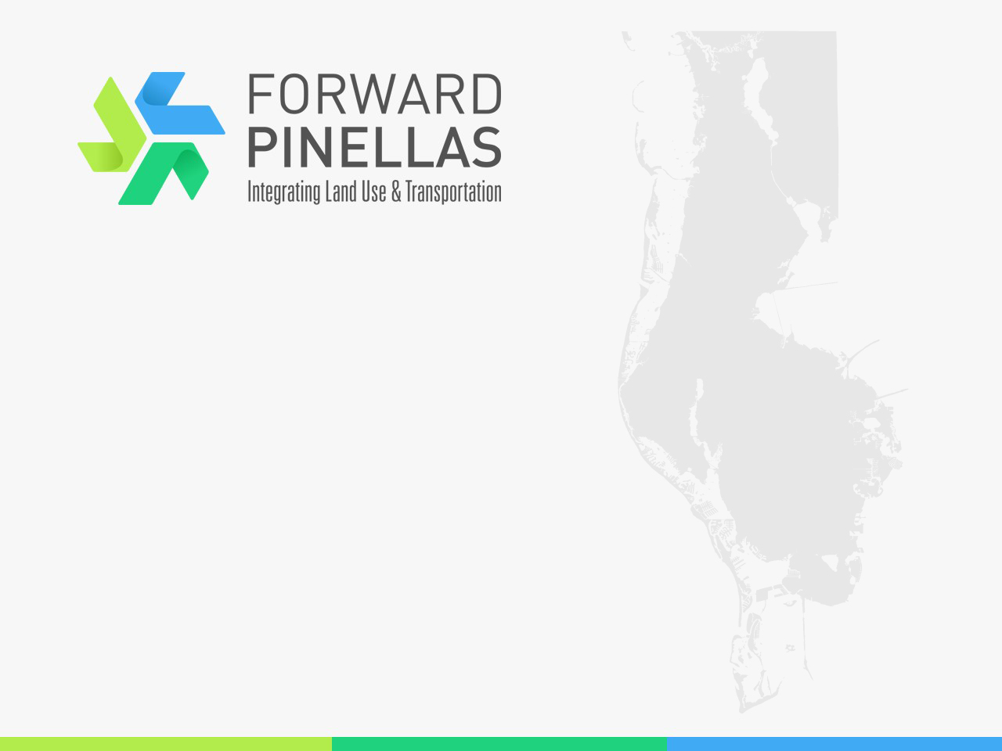
Call for Projects Webinar
July 20, 2023
We will begin shortly
The webinar is being recorded for those unable to attend live
Please mute yourself when not speaking
Please rename yourself in the participants tab to your first and last name
When you have a question, please raise your hand or indicate in the chat box

Slide 2
Call for Projects
July 20, 2023
Webinar

Slide 3
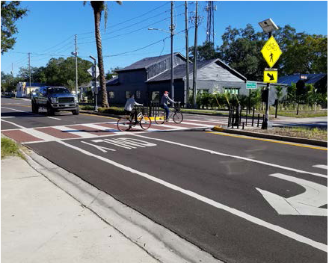
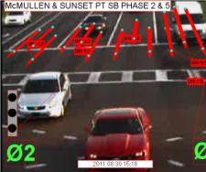
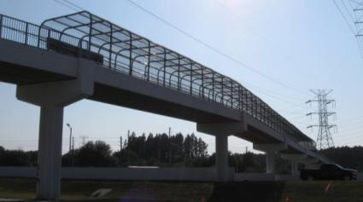
Role of Forward Pinellas
Align transportation funding that support land use goals and Advantage Pinellas
Develop annual list of priorities for state and federal funding
Work with FDOT to advance projects

Slide 4
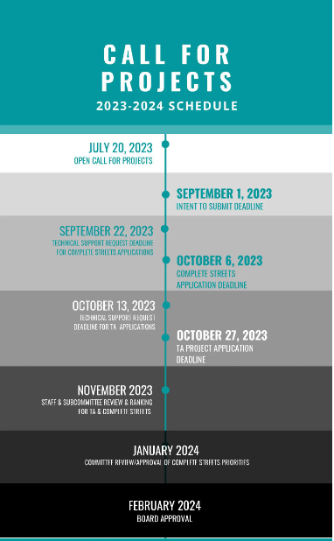
Forward Pinellas Grant Program
Complete Streets
Transportation Alternatives
Multimodal Priorities
No formal application structure
Recommend following application criteria for each program

Slide 5
Complete Streets

Slide 6
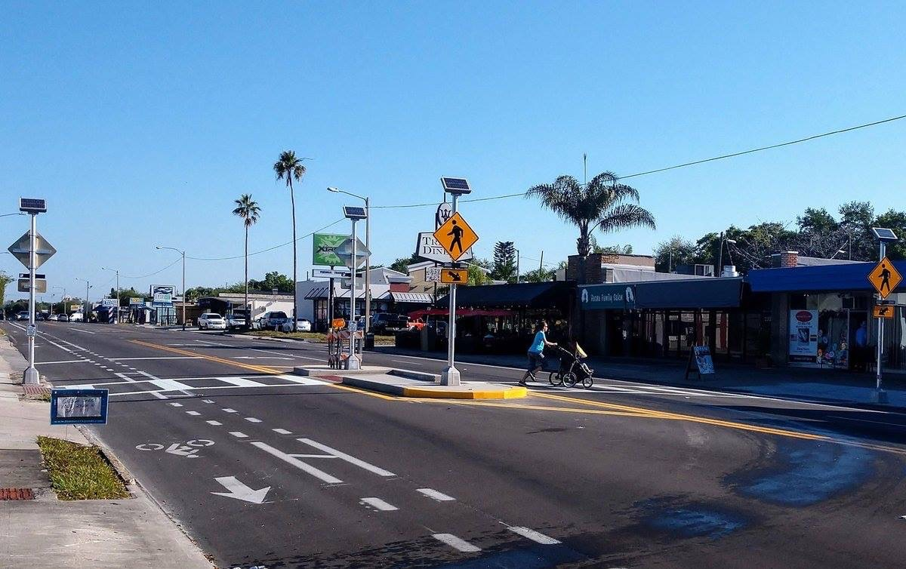
Complete Streets Program Overview
6th Year
$100K for Concept Planning
$1M for Construction
Leverage transportation funding to bring about transformative land use change

Slide 7
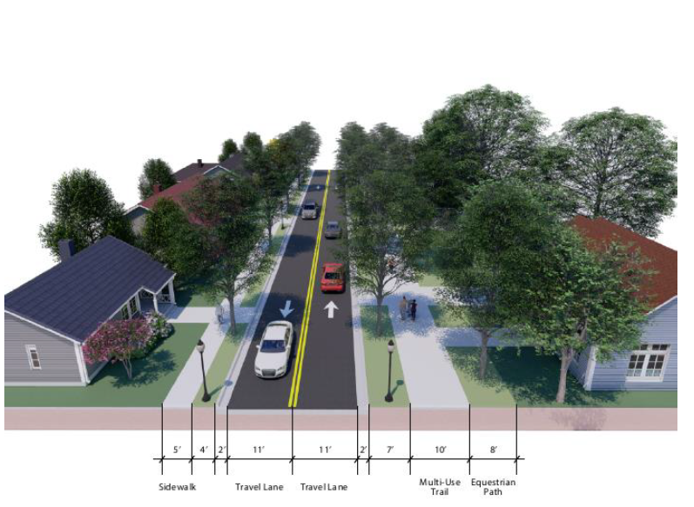
What are Complete Streets?
Complete Streets are streets for everyone, no matter who they are or how they travel.
Pedestrians, bicyclists, motorists, and public transportation users of all ages and abilities are able to safely move along and across a complete street.
Notes:
Projects which serve ALL modes, not just one.

Slide 8
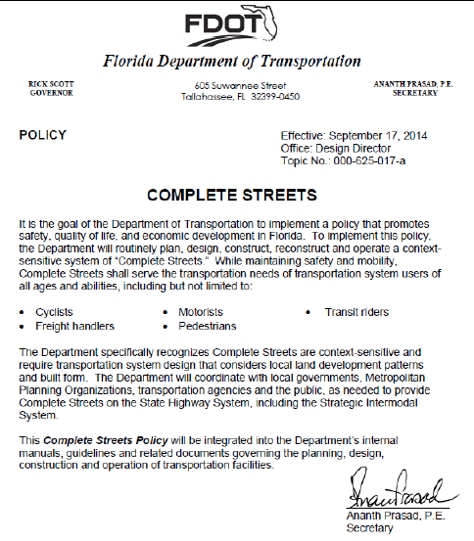
Complete Streets Policy
Ensure that the entire right-of-way is planned, designed, constructed, operated, and maintained to provide safe access for all users.
Works to ensure the transportation network works for all users every time there’s a new project.
Complete Streets policies are one important piece in ensuring our communities are fiscally and physically healthy.

Slide 9
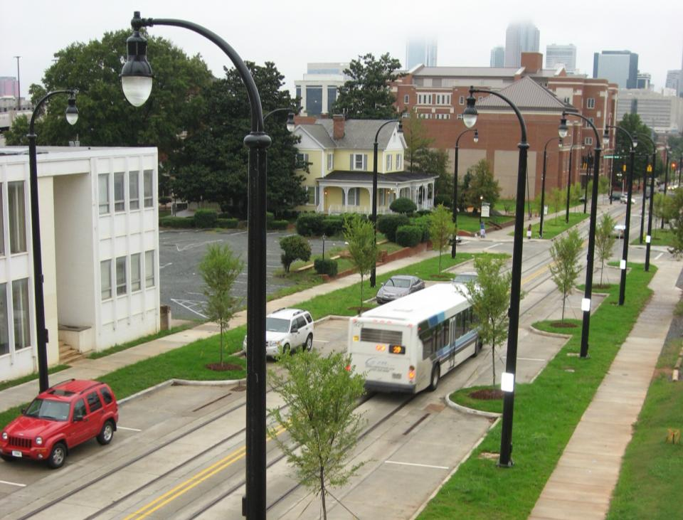
Complete Streets Program Overview
Competitive program
Annual solicitation
Technical assistance
  One on one meetings

Slide 10
Complete Streets Grant Program Overview
$100,000 for Concept Planning available in FY 2023
  Concept Planning requires formalized agreement with Forward Pinellas by July 1, 2023
  Forward Pinellas Consultants must be used for Concept Planning
$1.5 million for Construction Projects will be included in the fifth year of the 2024/25 – 2028/29 FDOT Work Program.
Projects are intended to bring about transformative land use change
  Projects surrounded by a diverse mix of undervalued/underutilized land uses will be the most competitive

Slide 11
Concept Planning Projects
Minimum criteria
  Local support
  Demonstrate how project serves as redevelopment catalyst
  Land use connection
Project Info:
  Existing conditions
  Cost estimate/local match
  How it will serve multiple modes
  Local planning requirements
  Path to implementation/const.
  % of vacant parcels
  % of land uses within ¼ mile
  EJ/TD considerations
  Food access
  Partial award

Slide 12
Construction Projects
Minimum Criteria
  Local support
  Demonstrate support as redevelopment catalyst
  Serve multiple modes
  LAP certification (or agreement)
  ROW available or secured
  Land use connection
  Completed FDOT “Surface Transportation Block Grant” Application

Slide 13
Construction Project Information
Project location and proposed improvements
Cost estimate/local match
Connections for low income/elderly
Local planning requirements
Project schedule
% vacant parcels in corridor
% of land uses within ¼ mile
EJ/TD considerations
Food access
Before/after study and photography
Signal timing review
Notes:
Target underserved, first mile last mile, low hanging fruit….what approach do you want to take?

Slide 14
Example: Concept Planning Award 2021
City of Tarpon Springs
Disston Avenue
$100k request; $68K match
  Directly abutting CRA
  Develop complete streets plan for corridor
  Project 1.9 mi. with 0.2 mi. gap
  Plan to provide multi-modal access to social, faith based, health, commercial and community institutions
  Lighting, enhanced crossings, ADA sidewalks
Existing Conditions

Slide 15
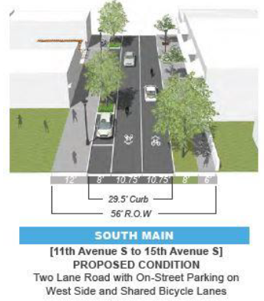
Example: Construction Award 2021
City of St. Petersburg
22nd St. South from 11th Ave South to 18th Ave South
Warehouse Arts District Deuces Live Joint Action Plan – Redevelopment Area
$1M request; $507K match
  Mix of land uses
  Minority and EJ Area
  Located within CRA
  Local trail and bike lane connections
  Widened and buffered pathway (bikes and pedestrians)
  Pedestrian crossings and bike lanes
  New bus stop locations
  Landscape amenities

Slide 16
Complete Streets Application Summary
Concise applications that meet all the application requirements are most desirable
Utilize application criteria to design/develop project ideas
For examples of previously submitted applications see this website: https://forwardpinellas.org/programs/complete-streets-program/
New for 2023:
  Increased funding amount for construction planning applications
  New EJ Report available: https://forwardpinellas.org/document-portal/advantage-pinellas-2050-long-range-transportation-plan/
  Differs from link included in application package

Slide 17
Complete Streets Program Summary
Technical assistance deadline: September 22, 2023
Application deadline: 5:00 p.m. on October 6, 2023
Committee recommendations: January 2024
Board approval: Feb 2024
Concept Planning agreement executed: July 1, 2024
  All phases complete and invoices executed by: June 30, 2025
Construction funding: 2029/30 work program
Notes:
As we continue to refine, we will be bringing back at every stage. Adjustments can be made.

Slide 18
Transportation Alternatives

Slide 19
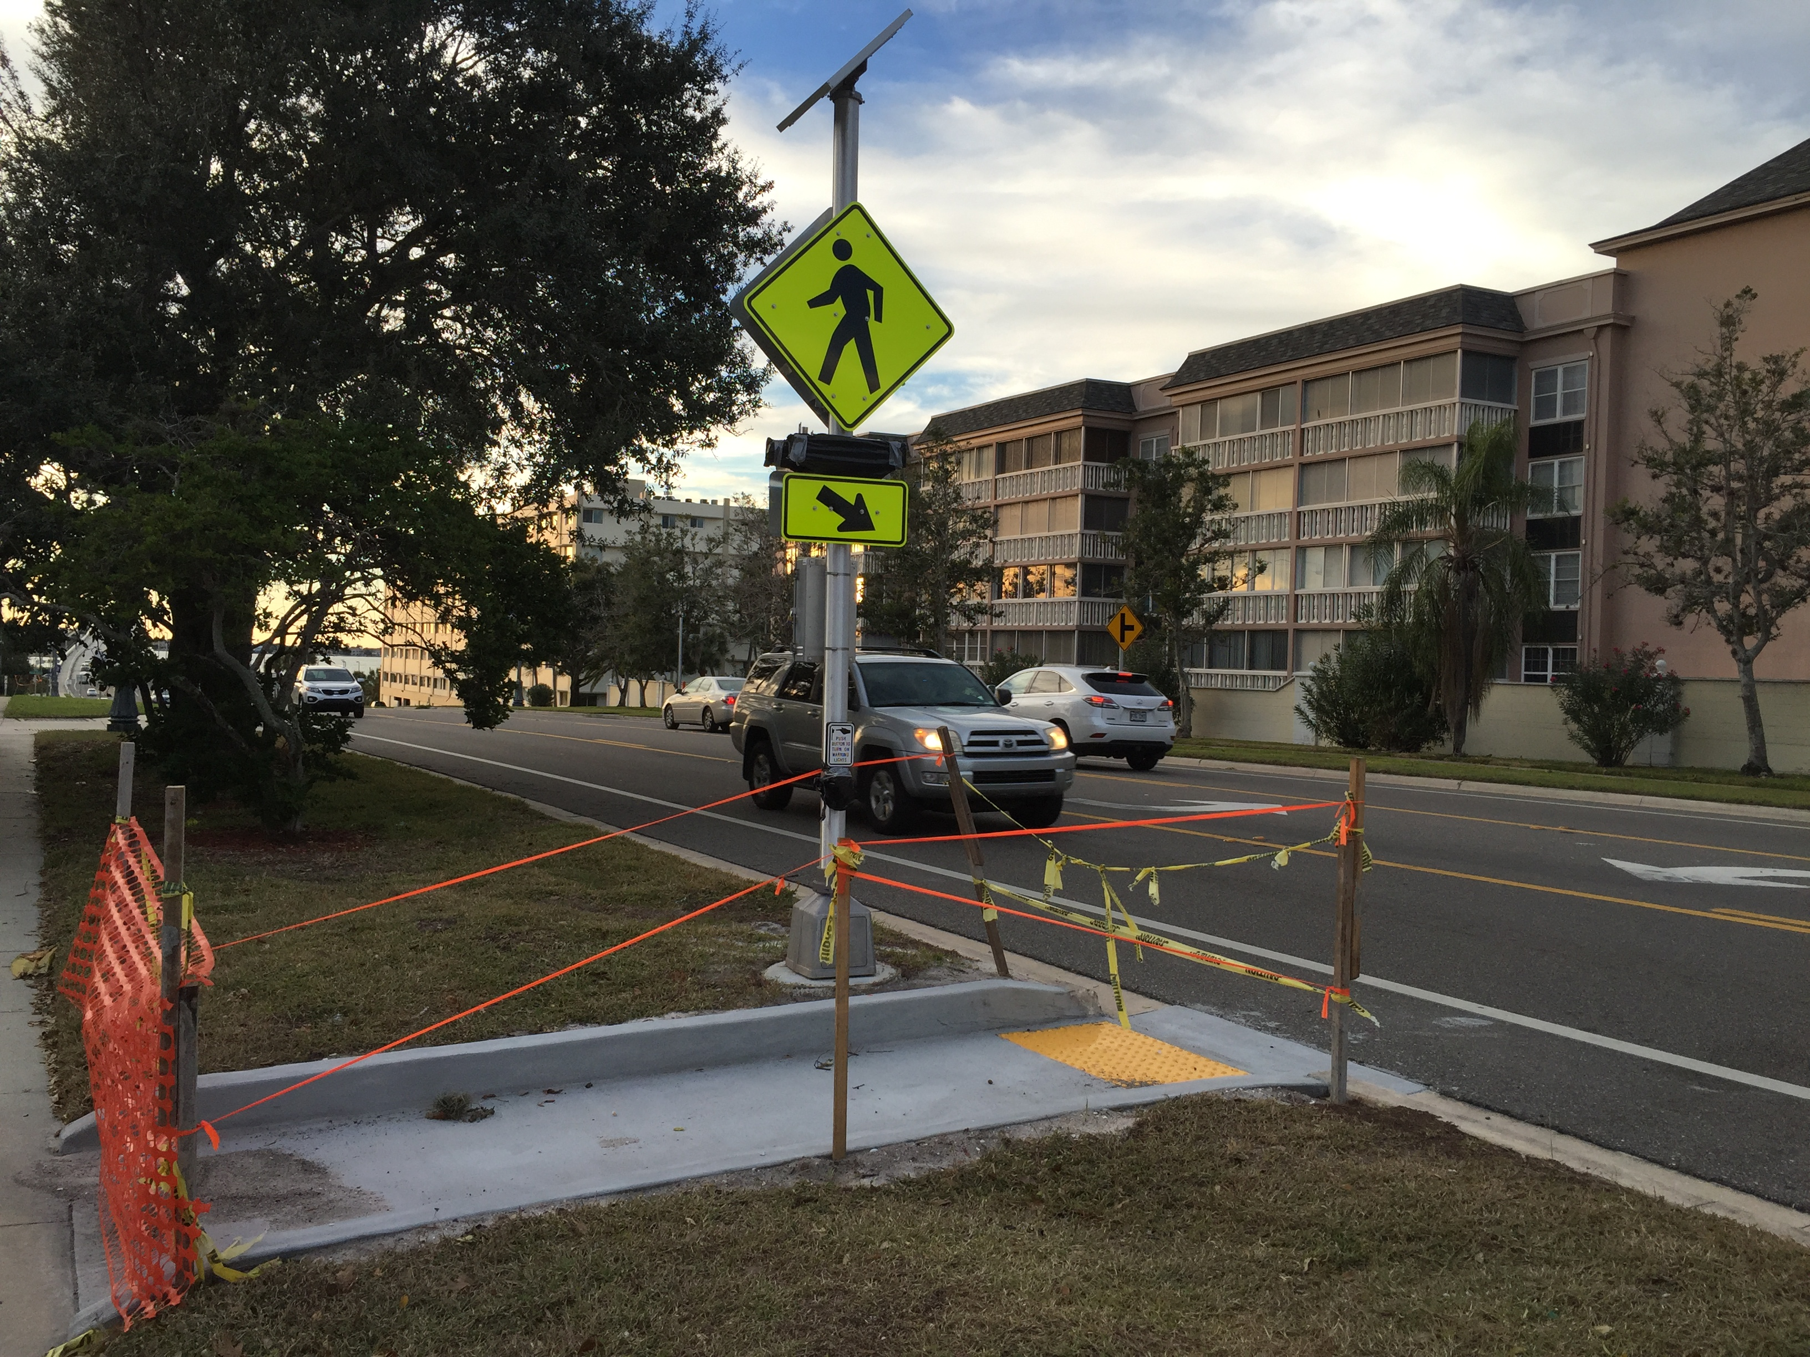
Eligible Projects
Pedestrian and bicycle projects
Infrastructure to improve non-driver access to transit service
Notes:
Application Prerequisites:
The application must include a resolution of support from the agency’s governing body and documentation of public support.
100% of right-of-way must be acquired or documentation of an easement provided.
Applying agency must be LAP certified, demonstrate a commitment to obtain LAP certification within a timely manner to implement the project or provide an agreement with a LAP certified agency to implement the project on their behalf.

Slide 20
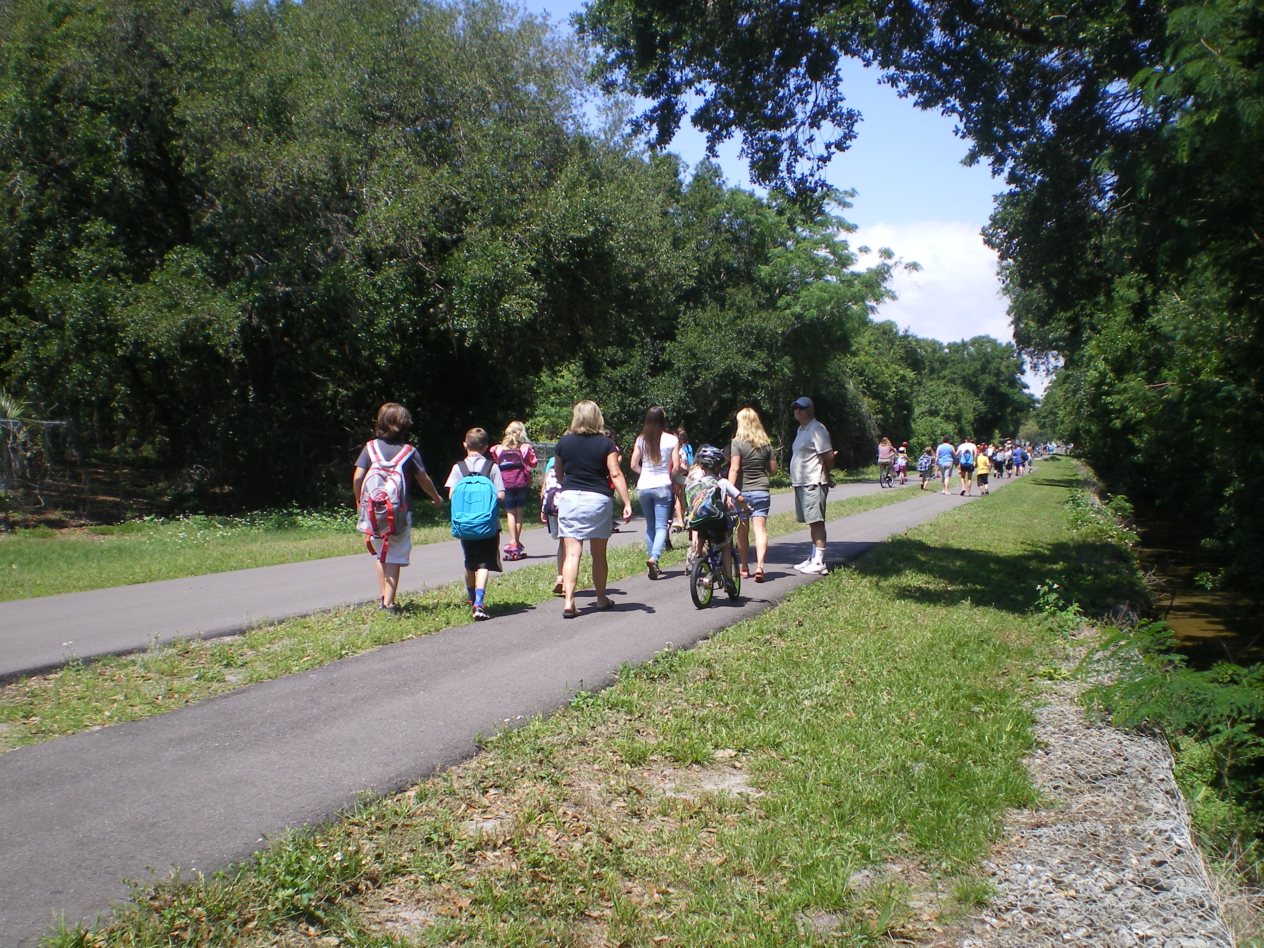
Program Structure
Minimum Award: $300k
Max Award: $3 million
3 submittals per jurisdiction
After 3 years, projects will be removed from the list
Prerequisites:
100% of ROW or easement
LAP Certification
Notes:
Application Prerequisites:
The application must include a resolution of support from the agency’s governing body and documentation of public support.
100% of right-of-way must be acquired or documentation of an easement provided.
Applying agency must be LAP certified, demonstrate a commitment to obtain LAP certification within a timely manner to implement the project or provide an agreement with a LAP certified agency to implement the project on their behalf.

Slide 21
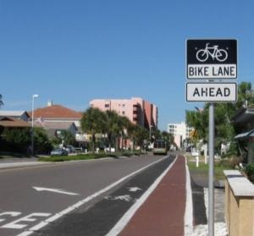
Scoring
Direct access to Multimodal corridor: 10 points
Direct access to Activity Center: 10 points
Identified in BPMP: 5 points
Fills a gap: 10 points
Direct access to priority transit route:
  30 minute headways or better: 10 points
  45-60 minute headways: 5 points
Direct access to Equity Emphasis Area: 15

Slide 22
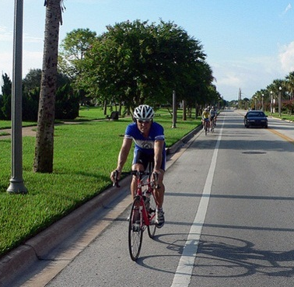
*Scoring
Bicycle Facilities (after completion of project/phase)
All Ages and Abilities: 15 points
Interested but concerned: 10 points
Enthused and Confident: 5
Strong and Fearless: 0
Sidewalk Projects (after completion of project/phase):
Separated corridor with a min 2’ buffer: 15 points
Sidewalks on both sides of the roadway: 10 points
Sidewalk on one side of the roadway: 5 points
*Scoring calculated by Forward Pinellas Staff
Notes:
Criteria details included in the TA Application Addendum
Stress that FP staff will do the computation for the bike facilities. Local governments can, however, can do their own calculations for sidewalk projects.

Slide 23
TA Applications
A properly completed Forward Pinellas TA Program Application Packet should include the following:
1. Florida Department of Transportation’s (FDOT) Surface Transportation Block Grant Program and Transportation Alternatives (TA) Set-Aside Program Project Application
2. Forward Pinellas TA Program Application Checklist
3. Forward Pinellas TA Program Application Addendum

Slide 24
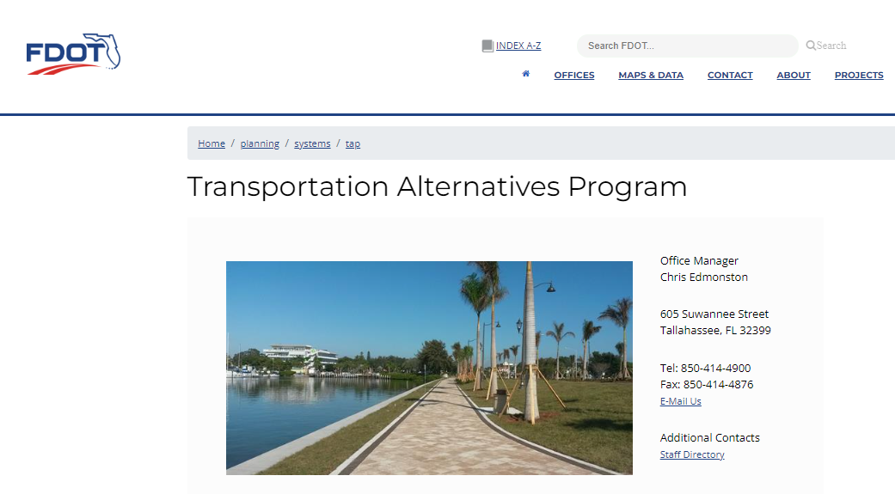
https://www.fdot.gov/planning/systems/tap/default.shtm

Slide 25
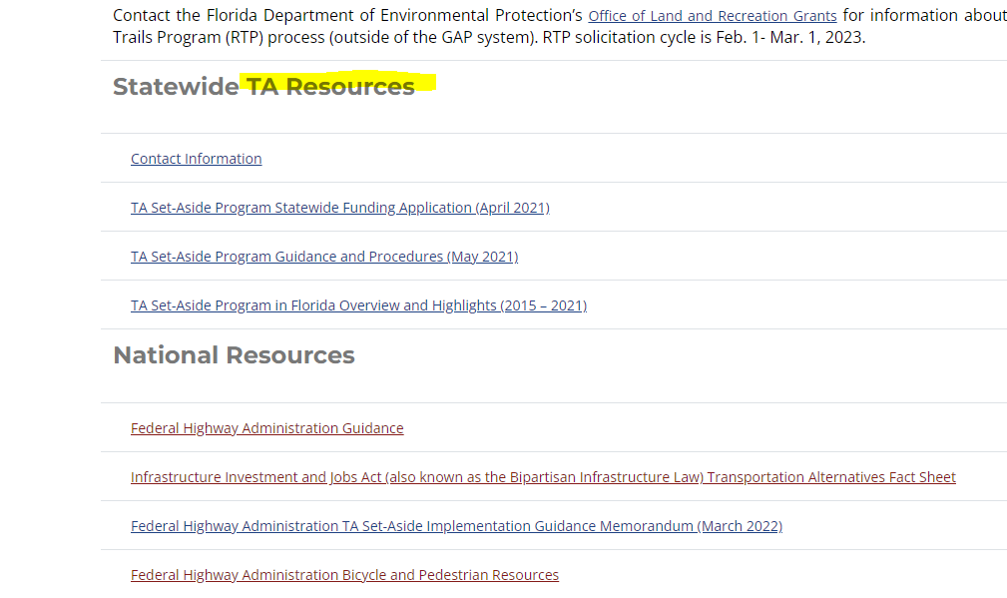

Slide 26
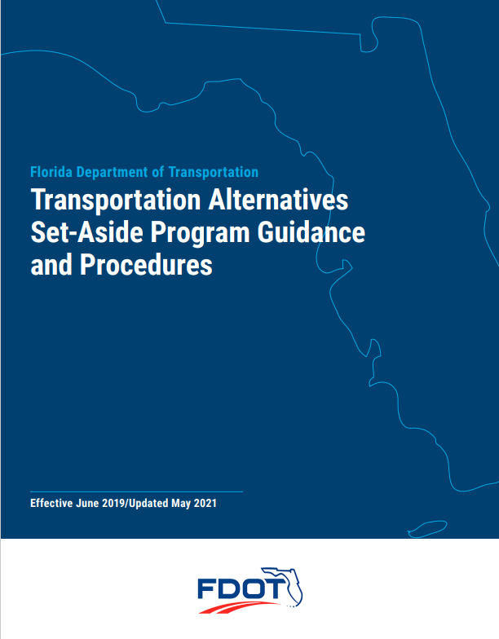
Notes:
Note that this is 2021 and may be updated along with the actual TA application prior to March 2023

Slide 27
2023 Call for Projects
TENTATIVE SCHEDULE
July 20th – webinar and open call for projects
September 1st - Local Government deadline to notify Forward Pinellas of intent to submit application for any of the open grant program
September 22nd – deadline to request technical assistance for Complete Streets applications
October 6th – deadline to submit any new Complete Streets Program projects
October/November – Complete streets presentation to TCC and PAC
October 13th - deadline to request technical assistance for TA applications
October 27th – deadline to submit TA applications
November – Complete Streets subcommittee review
January – Complete Streets to MPO committees
Feb – Complete streets to MPO board
March – deadline for GAP
Notes:
Need updated graphic here with TA portions highlighted

Slide 28
Multimodal Priorities
NOT THIS YEAR

Slide 29
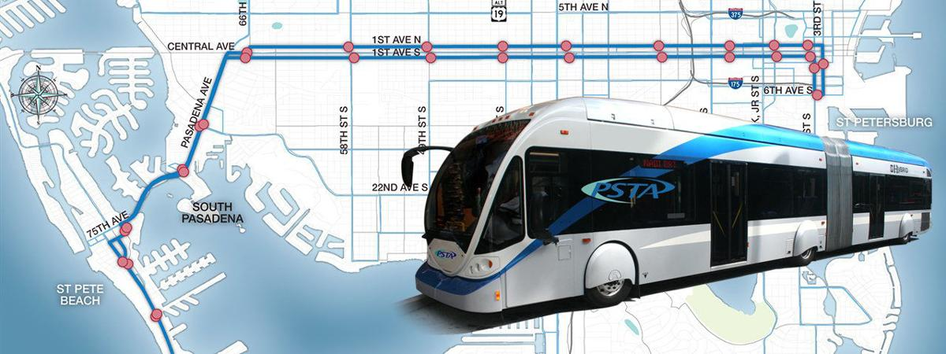
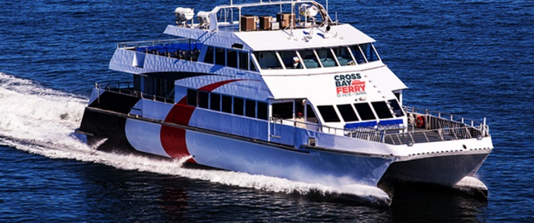
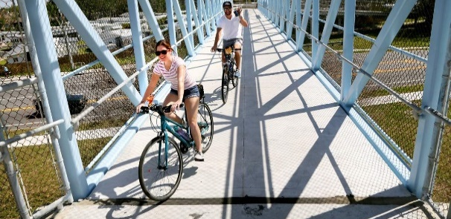
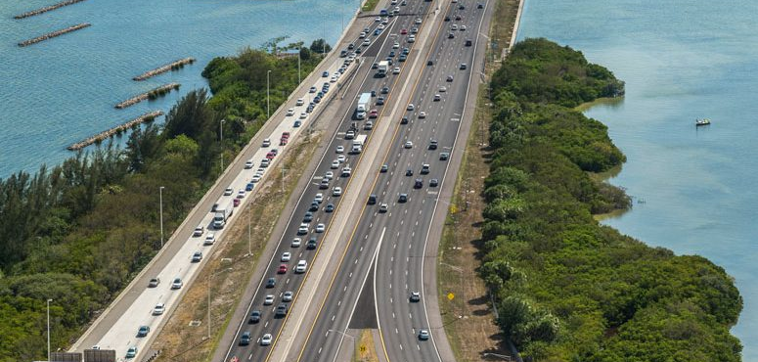
Multimodal Transportation Goals
Improve Safety
Enhance Equitable Outcomes
Improve Mobility
Foster Economic Growth
Protect the Environment
Improve Resiliency
Criteria applied to all projects, regardless of mode, unless otherwise noted
Program structure document includes detail on how criteria will be applied
Advancement of projects is at the sole discretion of the Forward Pinellas Board and will not necessarily include the projects receiving the highest number of points

Slide 30
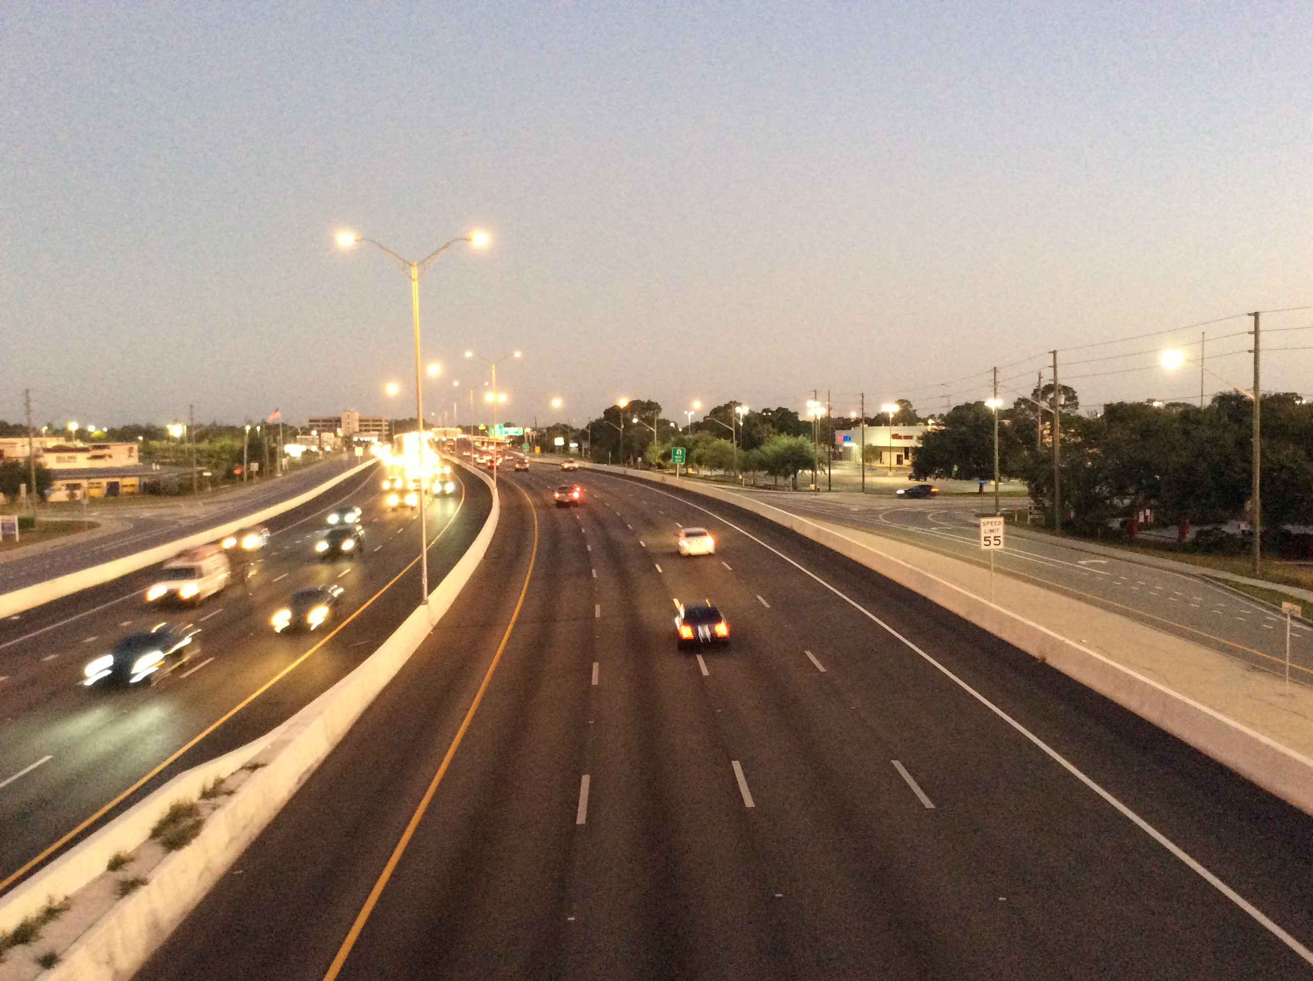
Grant Program Structure
Minimum project cost $350K
Max 3 applications/entity
All modes considered
  Roadway, transit capital, technology
  However, no bike/ped standalone
Evaluated against criteria that support goals
Advanced in ranges
  High
  Medium-High
  Medium
  Low

Slide 31
Proposed Scoring for Multimodal Priorities
Other Considerations:
Project Readiness
Countywide Significance
Public and local government support

Slide 32
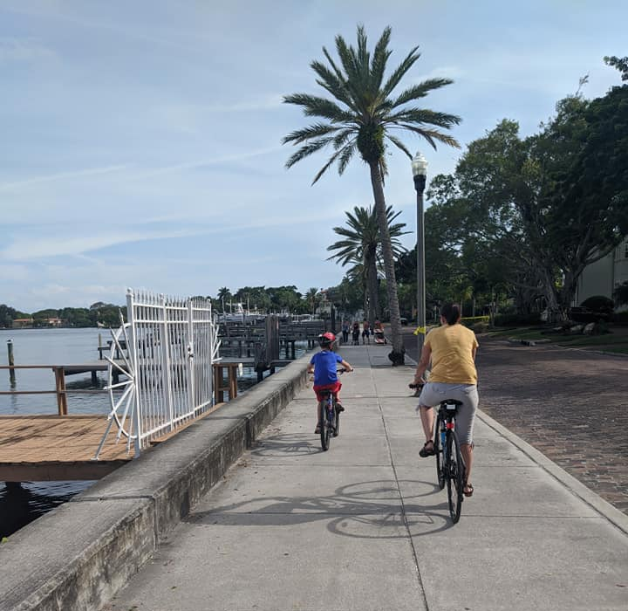
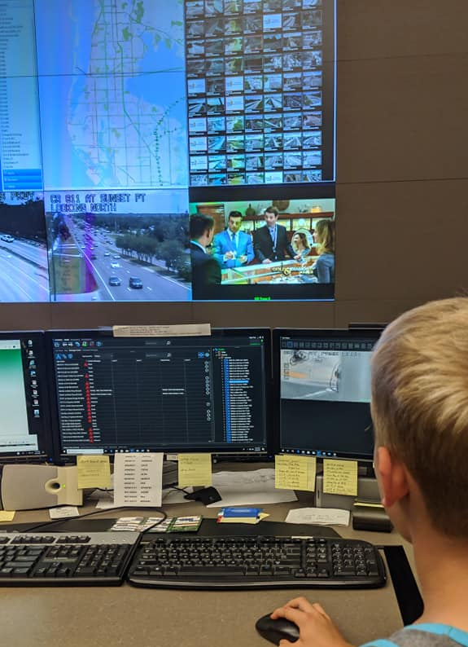
Review Process
Internal review by multiple Forward Pinellas staff
Independent scoring against criteria followed by group scoring
One-on-one meetings with applicants to explain how scoring was applied to each criteria
Committee recommendations
Forward Pinellas Board Action

Slide 33
Timeline for Multimodal Priorities
Applications due by: December 16th
All questions: cfavero@forwardpinellas.org
Winter: Internal review
Jan/Feb 2023: One-on-one meetings with applicants
June 2023: Added to priority list for funding consideration in 2024/25-2028/29 FDOT Work Program

Slide 34
Next Steps

Slide 35
Questions?
Kyle Simpson, AICP ksimpson@forwardpinellas.org Robert Feigel rfeigel@forwardpinellas.org
Chelsea Favero, AICP cfavero@forwardpinellas.org

