Slide 1
Knowledge Exchange Series: A Guide to Micromobility in Pinellas County
Technical Coordinating Committee
June 23, 2021

Slide 2
What is a Knowledge Exchange Series?

Slide 3
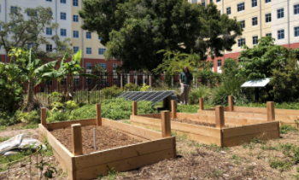
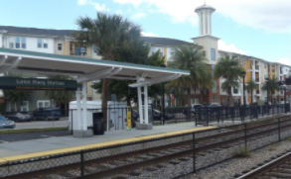
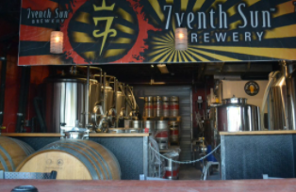
Knowledge Exchange Series
Knowledge Exchange Series (KES):
Emerging planning topics
Collaboration with partners
Research and best practices
Guide for policy and regulatory practices
Past KES topics:
Microbrewery development in downtown areas
“Missing middle” housing
Advancing urban agriculture
Transit oriented development

Slide 4
Process
Literature review
Local and national research
Partner collaboration
Interviews
Report development
Public outreach

Slide 5
Micromobility KES Overview and Key Findings

Slide 6
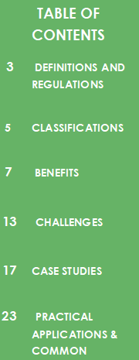
Micromobility KES Overview
State Statutes
Literature definitions
Detailed tables for classifications
Overall benefits
Overall challenges
City of St. Petersburg case study
City of Tampa case study
Practical application to address
common questions

Slide 7
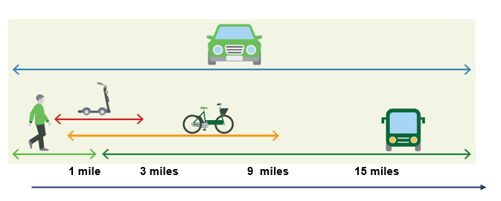
Micromobility KES Key Findings
First-mile / Last-mile solutions!
Graph from NACTO Report “Shared Micromobility in the US: 2018”
Continual data collection and analysis essential
to identify travel dynamics and fill gaps!

Slide 8
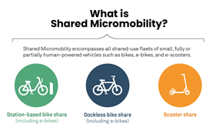
Micromobility KES Key Findings: Classifications
Interview feedback resulted in these top needs:
Detailed delineation between micromobility devices and share programs;
Delineation between small vehicles and micromobility devices;
Source for micromobility device classifications;
Practical applications for ordinances and share programs.

Slide 9
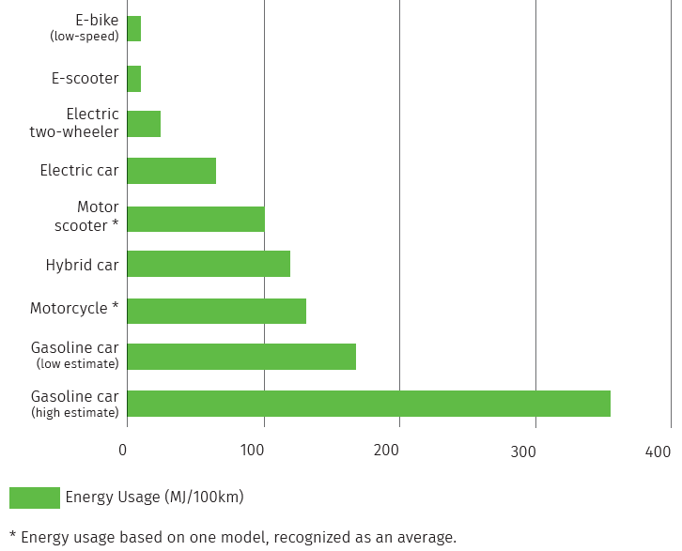
Micromobility KES Key Findings: Environmental Benefits
Low energy consumption
Sustainable transportation mode
E-scooter study in Portland: 1-year pilot prevented 122 metric tons of carbon dioxide emissions = removal of 300,000 vehicle miles
Manage batteries and disposal of devices through waste management

Slide 10
Micromobility KES Key Findings: Resource Efficiency
In Pinellas County, households spend an average of 24% of their budget on transportation costs
Transit Orientated Development (TOD) in combination with micromobility provides for a reliable, safe, connected network
Ability to reduce household costs for vehicle purchase, maintenance, fueling and insurance
Plan to connect employment centers, commercial areas and tourist destinations
Example: University of Tampa and nearby Walmart corrals

Slide 11
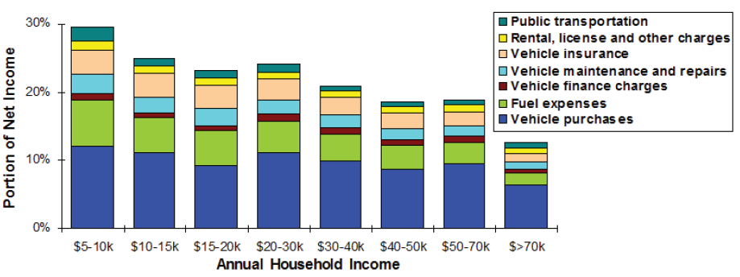
Micromobility KES Key Findings: Equity
“Transportation is the single strongest factor in the odds of escaping poverty. The longer an average commute in a given country, the worse the chances of low-income families there moving up the ladder.”

Slide 12
Micromobility KES Key Findings: Equity
Incorporate equity policies, goals and objectives in share programs.
Equity zones
Cash options
Discounted memberships
Free training and inexpensive gear
Promotion and education
Three-wheel scooters and bikes, cargo bikes, as well as ADA cycle options
Continual data collection and analysis

Slide 13
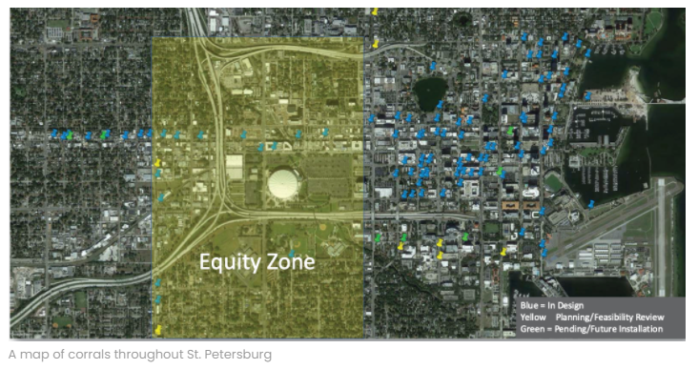
City of St. Petersburg Micromobility Equity Zone

Slide 14
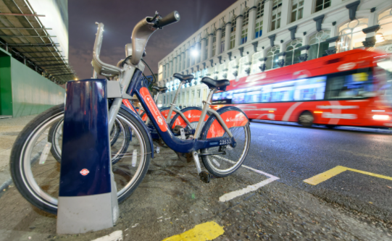
Micromobility KES Key Findings: Connectivity
Micromobility devices encourage transit use by providing multi-modal opportunities within a pedestrian shed or walkshed.
E-scooters, e-bikes and bike share programs fill gaps in transportation networks
Used as “floating transportation options”
Plan to couple docking stations / corrals at transit hubs

Slide 15
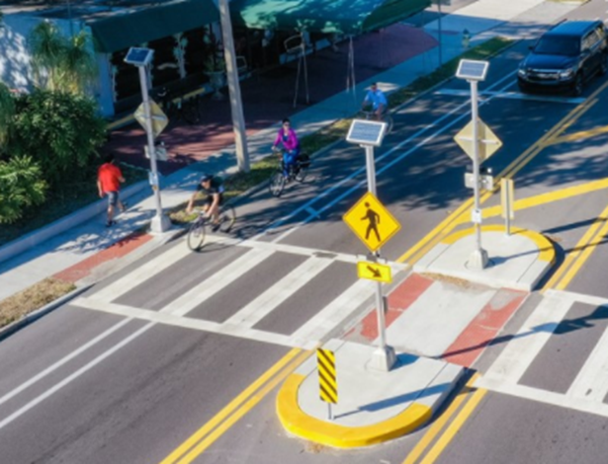
Micromobility KES Key Findings: Safety Concerns
How to address safety concerns?
Safety regularly ranked as #1 public concern across the Nation
Requirement for vendor crash reporting data
Free gear, lights and reflective vests
Education and training requirements for rental purchases
Public training workshops
Infrastructure:
Complete Streets
“Third-lanes”
Micromobility share programs
Vendor staff support

Slide 16
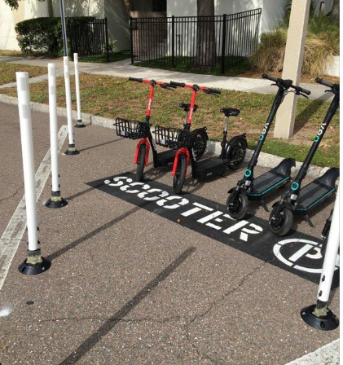
Micromobility KES Key Findings: Managing the Right-of-Way
Parking Corrals in St. Petersburg
Exclusive for e-scooter, e-bike and/or pedal assist bikes
Scooter bounty program in the City of Tampa
Monetary award system
Exclusionary zones with access areas around heavily used pedestrian areas

Slide 17
Micromobility KES Key Findings: Health and Quality of Life
CDC: Quality of transportation infrastructure impacts quality of life
74% of e-scooters users reported never using a bike share system
42% of e-scooter users reported never bicycling
Lack of physical = high rate of health problems
Micromobility can increase active transportation and TRANSIT

Slide 18
Case Studies and Practical Applications

Slide 19
Case Study: Micromobility in Pinellas County

Slide 20
City of St. Petersburg Micromobility Program
Collaboration with City staff:
10-years experience
Successful program = monitor and evolve
Case study outlining practical applications and lessons learned
Important considerations for micromobility programs
Example ordinances
Thanks City of St. Petersburg staff!

Slide 21
Case Study: Micromobility in Florida

Slide 22
City of Tampa Micromobility Program
Success through problem solving and flexible framework
Strategic planning for connectivity and dependability
Equity zones implementation
Affordable system
Lock to technology
Bounty program
Charging stations in specific areas
Continual data collection and analysis

Slide 23
Practical Application Section
Where to establish micromobility programs?
How do systems operate?
What about personal transportation devices?
How to get started?
What is the future of micromobility in Pinellas County?
Hint: Consistency is key!

Slide 24
What is next for the Micromobility KES?

Slide 25
Next Steps
Continual collaboration with county, state and federal partners
Micromobility forum
Committee presentations
Video development and promotion of report
“Living document” as technology, data and laws evolve

Slide 26
Questions & Comments

