Slide 1
Sun Coast Transportation Planning Alliance
Whit Blanton, FAICP
Executive Director

Slide 2
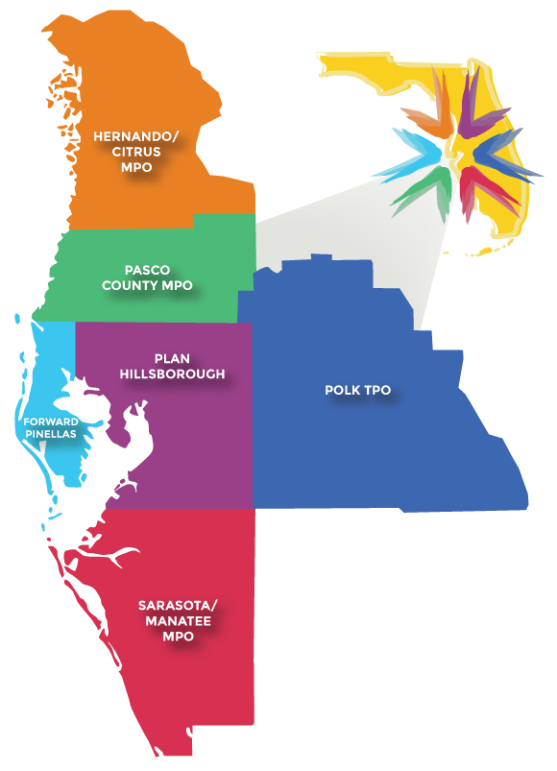
Strengthening the Focus on One Region, One Voice
MPO merger study in 2018
Interlocal agreement integrating the TMA Leadership Group into the Chairs Coordinating Committee framework
TMA Elections – a chair and vice chairs to lead the dialogue
Develop Branding & Website – create an identity and presence for consistent communications
Create Communications Strategy – build on the prior steps
Develop Plans Regionally – work through this framework to develop regionally significant investment strategies

Slide 3
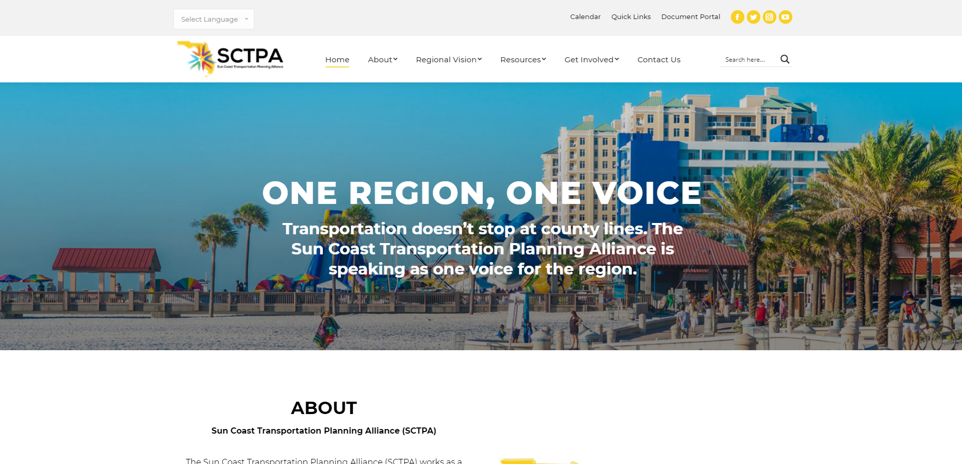

Slide 4
Questions?
Whit Blanton, FAICP
wblanton@forwardpinellas.org

