Slide 1
Intra-Regional Transit Service Case Study Examples
TMA Leadership Group Meeting
June 25, 2021

Slide 2
Case Study Examples
Sarasota County and Manatee County, Florida
Sarasota County Area Transit (SCAT) and Manatee County Area Transit (MCAT)
Route 99
Broward County and Miami-Dade County, Florida
Broward County Transit (BCT) and Miami-Dade County Department of Transportation and Public Works (DTPW)
I-95 Express Routes
Winston-Salem, Greensboro and High Point Region, North Carolina
Piedmont Authority for Regional Transportation (PART)
Routes 4 and 6

Slide 3
Sarasota County and Manatee County, Florida
Route 99 provides service from downtown Sarasota to downtown Bradenton
Facilitated by an Interlocal Agreement
Operations
Route 99 jointly operated by SCAT and MCAT
5 vehicles operate on the corridor during peak
2 by MCAT and 3 by SCAT
30-minute frequency
Fares
Retained by each respective agency
Passengers charged based on county in which they board
Bus passes honored on route
Source: Google Street View
Notes:
MCAT have also received funding through the MPO to improve Route 99 to 20-minute service (currently its 30-minute service.) The new schedule still has three SCAT buses and will now be using 4 MCAT buses They plan to start the new service in December 2021 or January 2022.
Route 99
30-minute Frequency (soon to be 20 minutes starting in Dec 2021/Jan 2022)
Operates all day Monday – Saturday from about 5:00 AM to 10 PM
Length of route is 15.2 miles each way (about 30 miles roundtrip)

Slide 4
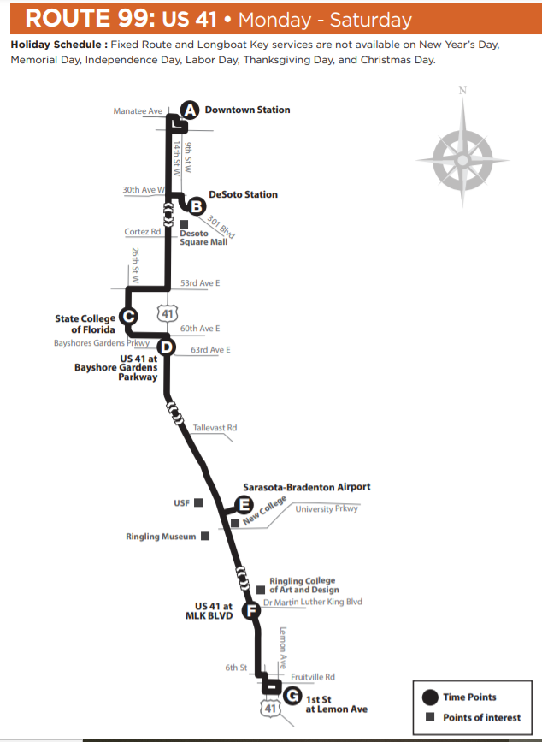
About Route 99
Combined ridership for both MCAT and SCAT pre-COVID consistently exceeds over 500,000 trips annually
MCAT has invested over $2.3M into transit capital investments and existing service in recent years
FY 2020 TRIPS, OPERATING COSTS AND REVENUE
Agency | Annual Unlinked Passenger Trips | Annual Revenue Hours* | Annual Farebox Revenue | Annual Operating Cost Per Revenue Hour | Annual Operating Cost Per Passenger Trip
MCAT | 192,038 | 10,011 | $49,583.78* | $1,072,478.43 | $1,724,501.24
SCAT | 275,657 | 14,796 | $54,996.68** | $1,672,095.96 | $2,877,859.08
Manatee County
Sarasota County
*MCAT Route 99 was FARE Free APRIL-NOVEMBER 2020
**All SCAT routes were FARE Free from MARCH 20, 2020 to date
Source: Sarasota County Area Transit
Notes:
MCAT data shows between Jan and March 2019, approx. 580 riders boarded at Sarasota County stops and approx. 1,030 riders boarded at Manatee County stops.

Slide 5
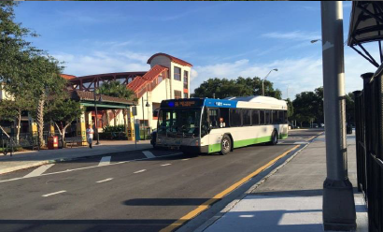
Broward County and Miami-Dade County, Florida
I-95 Express routes provide service from Broward County to Miami-Dade County
Facilitated by an Urban Partnership Agreement – routes funded by FDOT
Operations
Operated by BCT and Miami-Dade DTPW
Miami-Dade DTPW operates 2 routes
Service from downtown Ft. Lauderdale
and Hollywood to downtown Miami/Civic Center
BCT operates 3 routes
Service from Miramar and Pembroke Pines to
downtown Miami/Civic Center
Fares
Retained by each respective agency
Source: FDOT
Notes:
Rationale for funding by FHWA- In May 2006, the Department announced a major initiative to reduce transportation system congestion. This plan, the National Strategy to Reduce Congestion on America's Transportation Network (the “Congestion Initiative”), provides a blueprint for Federal, State, and local officials to consider as they work together to reverse the alarming trends of congestion. One major component of the Congestion Initiative is the Urban Partnership Agreement (or “UPA”). As announced in the Department’s solicitation for Urban Partners published in the Federal Register on December 8, 2006 (at 71 FR 71231 (2006)) (the “Federal Register Notice”), applicants designated by the Department as Urban Partners would adopt the “Four Ts:” tolling (congestion pricing), transit, telecommuting and technology – strategies believed to be effective on a combined basis in reducing traffic congestion. In return for such commitment, the Department, to the extent requested and appropriate, would support its Urban Partners’ implementation of the Four Ts with financial resources, regulatory flexibility, and dedicated expertise and personnel.
With regard to timeframe, the Department has committed to continuing the Express Bus funding for as long as the Express Lanes are in operations. This commitment is shown over the 5-years of the work program and in the 10-year and 25-year projections of Express Lanes needs as required by the Central Office Finance Office.

Slide 6
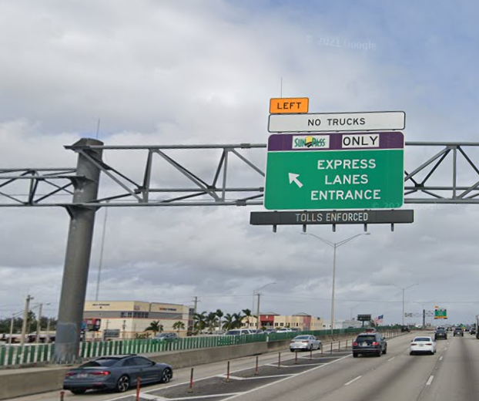
I-95 Express Routes: Miami-Dade DTPW
Two routes – each have two legs
Alternate between two PNR lots in Broward
Route I-95 Dade-Broward Express
From January – March 2020 the route averaged:
680 passengers per weekday
11.22 passenger weekday boardings per revenue hour
$20.18 net cost per weekday passenger boarding
Route I-95 Dade-Broward Express (Civic Center)
From January – March 2020 the route averaged:
383 passengers per weekday
7.72 passenger weekday boardings per revenue hour
$25.47 net cost per weekday passenger boarding
Source: Google Street View
Notes:
I-95 Express Routes – Miami-Dade DTPW -Dade-Broward Express
15-minute Frequency
Operates in the AM and PM peak on Monday-Friday from about 5:45 AM until about 7:30 or 8:00 PM (7:30 for Sheridan St, 8 for Broward Blvd)
I-95 Express Routes – Miami-Dade DTPW – Dade-Broward Express (Civic Center)
30-minute Frequency
Operates in the AM and PM peak on Monday-Friday from about 5:30 AM until about 9:00 PM

Slide 7
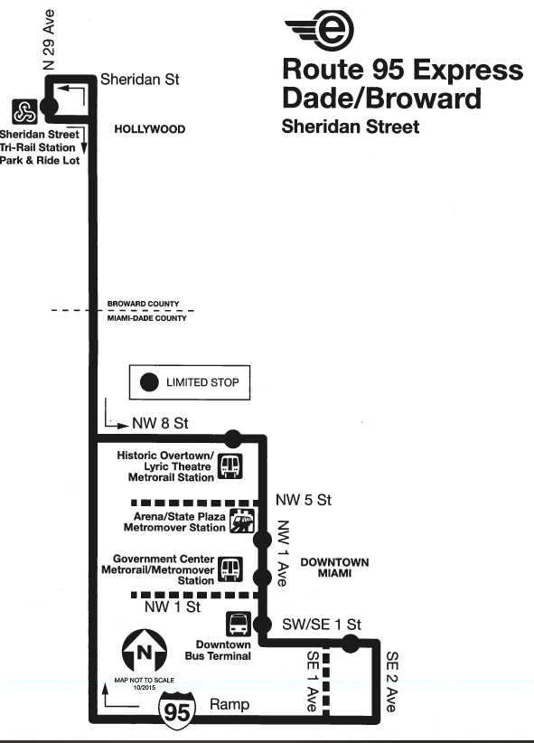
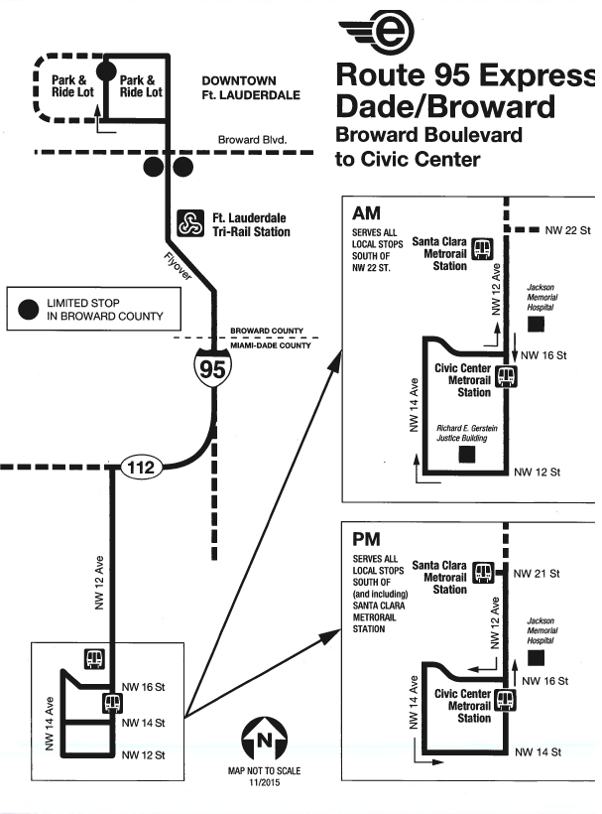
I-95 Express Routes: Miami-Dade DTPW

Slide 8
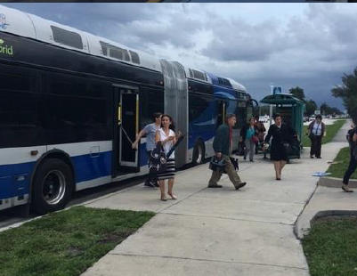
I-95 Express Routes: Broward County Transit
Three routes
Estimated Annual Operating Cost for all three routes: $2,158,040‬
I-95 Express Miramar Route 106
I-95 Express Pembroke Pines Route 108
I-95 Express Pembroke Pines/Brickell Route 109
BCT I-95 Express Routes Ridership and Revenue Jan-March 2020
 | Revenue Hours | Farebox Revenue | Ridership
Route 106 | 2,319.81 | $10,623.09 | 27,568
Route 108 | 1,700.53 | $13,476.12 | 26,985
Route 109 | 2,466.18 | $13,718.12 | 33,312
Source: FDOT
Notes:
I-95 Express Routes- BCT – Route 106
About 30-minute Frequency
Operates in the AM and PM peak on Monday-Friday from about 5:00 AM until about 9:30 PM
I-95 Express Routes- BCT – Route 108
About 30-minute Frequency
Operates in the AM and PM peak on Monday-Friday from about 5:00 AM until about 9:00 PM
I-95 Express Routes- BCT – Route 109
About 30-minute Frequency
Operates in the AM and PM peak on Monday-Friday from about 5:00 AM until about 8:00 PM

Slide 9
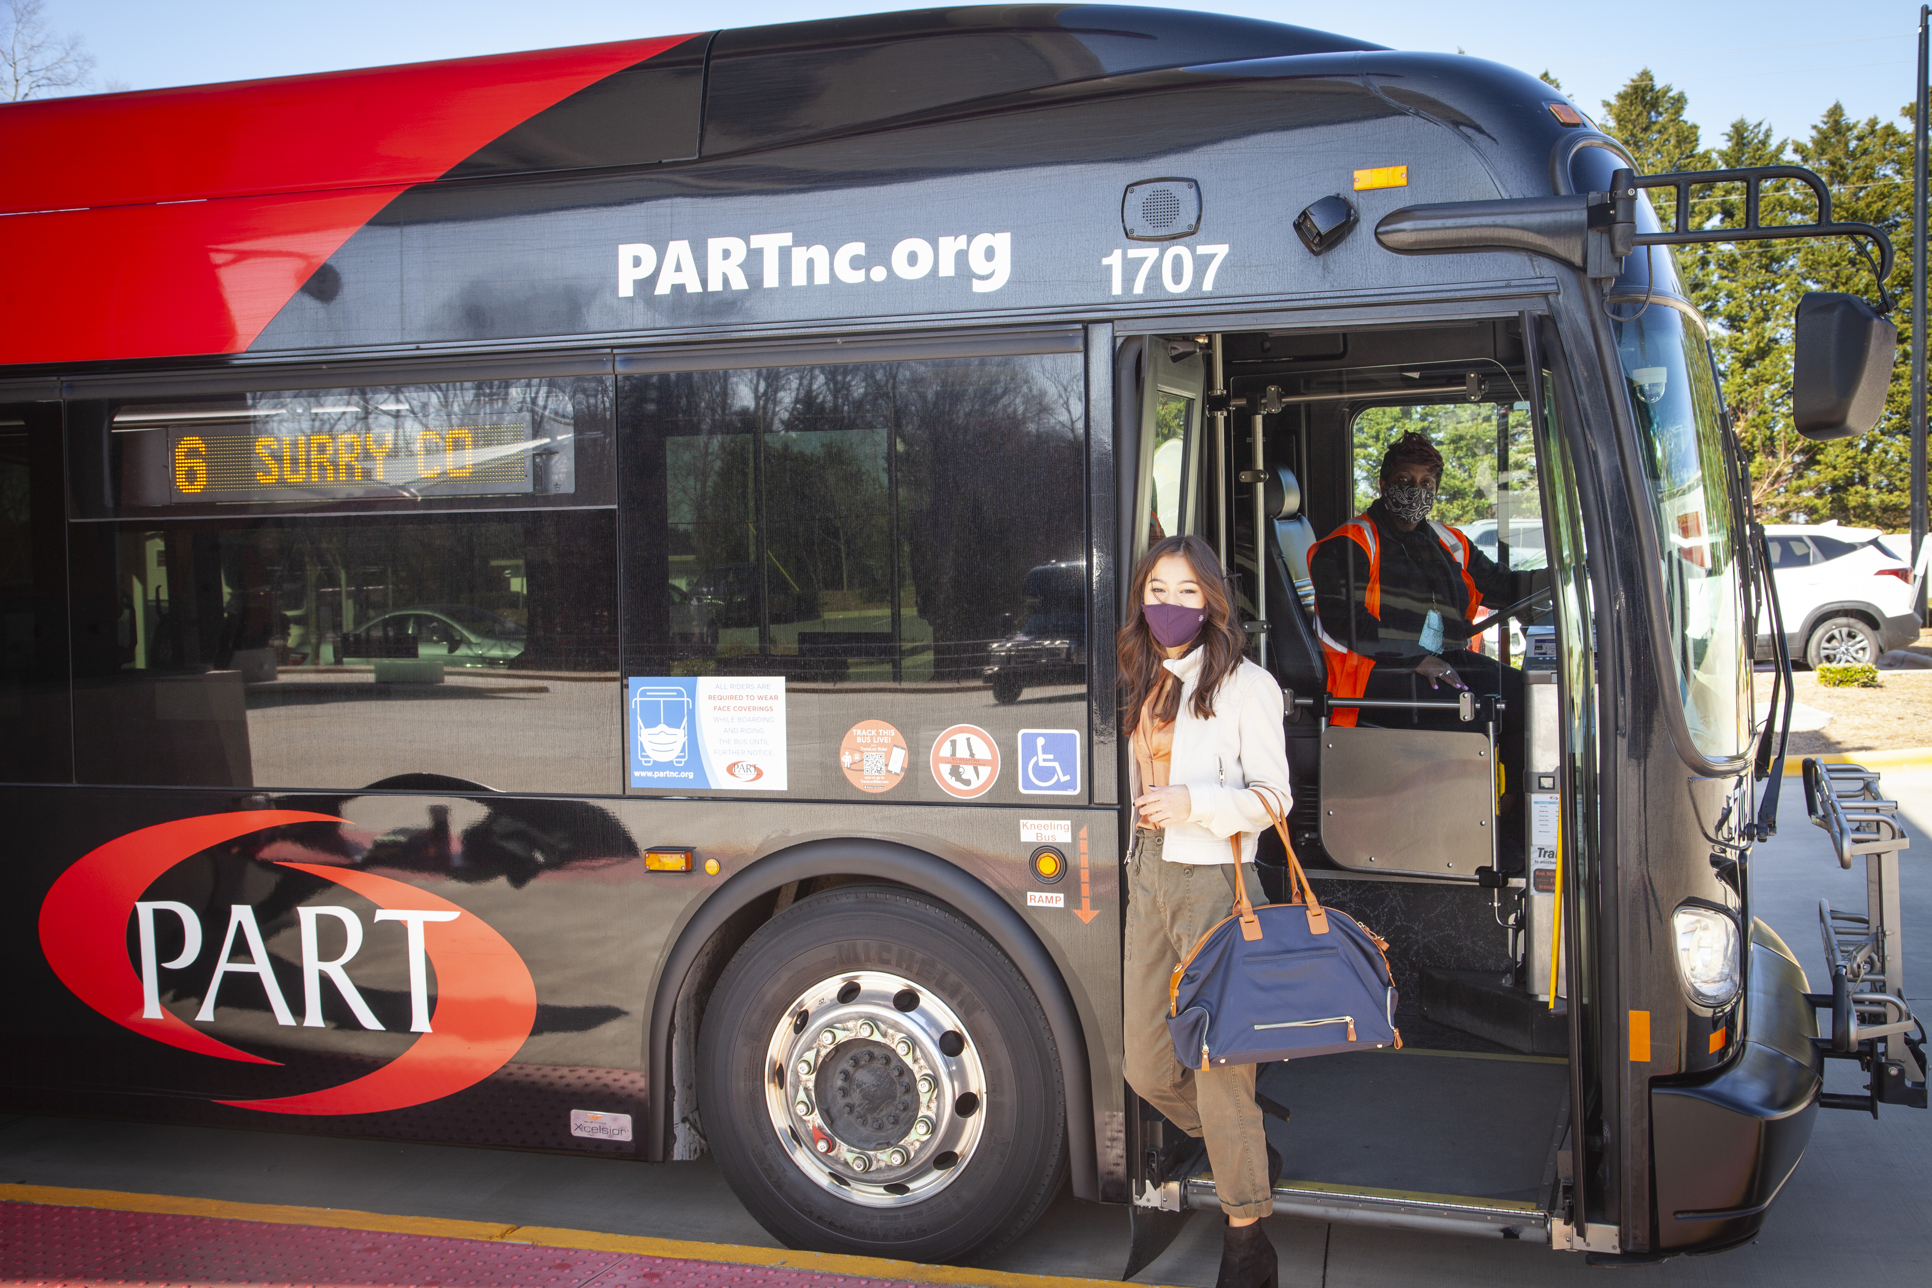
Winston-Salem, Greensboro and High Point Region, North Carolina
Piedmont Authority for Regional Transportation (PART)
Work with other MPOs and cities to coordinate service (no agreement in place)
Operations
Route 4
Provides service from Greensboro to Chapel Hill
Route 6
Provides service from Mt. Airy to Winston-Salem
Funding
5307 funds, 5337 funds, State/MPO funds
Each county receiving service has to approve a tax to be levied by PART - a vehicle rental tax or a vehicle registration fee
The vehicle rental tax is used to heavily subsidize all the rural routes
Source: PART

Slide 10
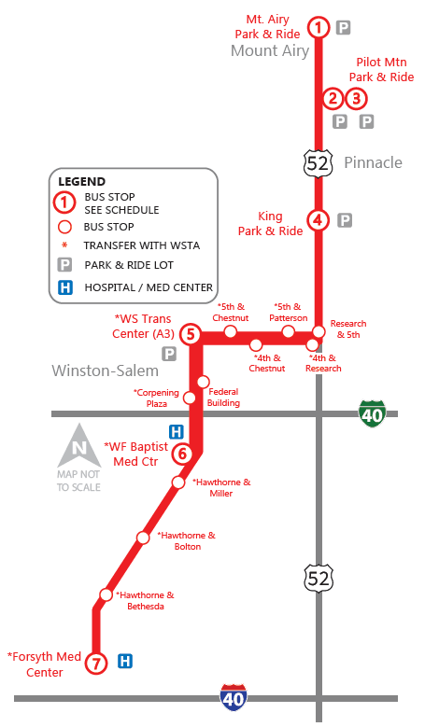
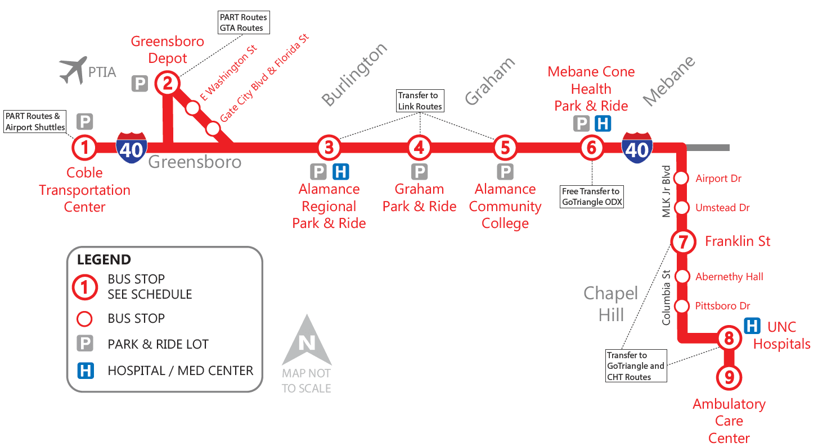
Routes 4 & 6: PART
Surry County Express Route 6
Alamance Burlington Express Route 4

Slide 11
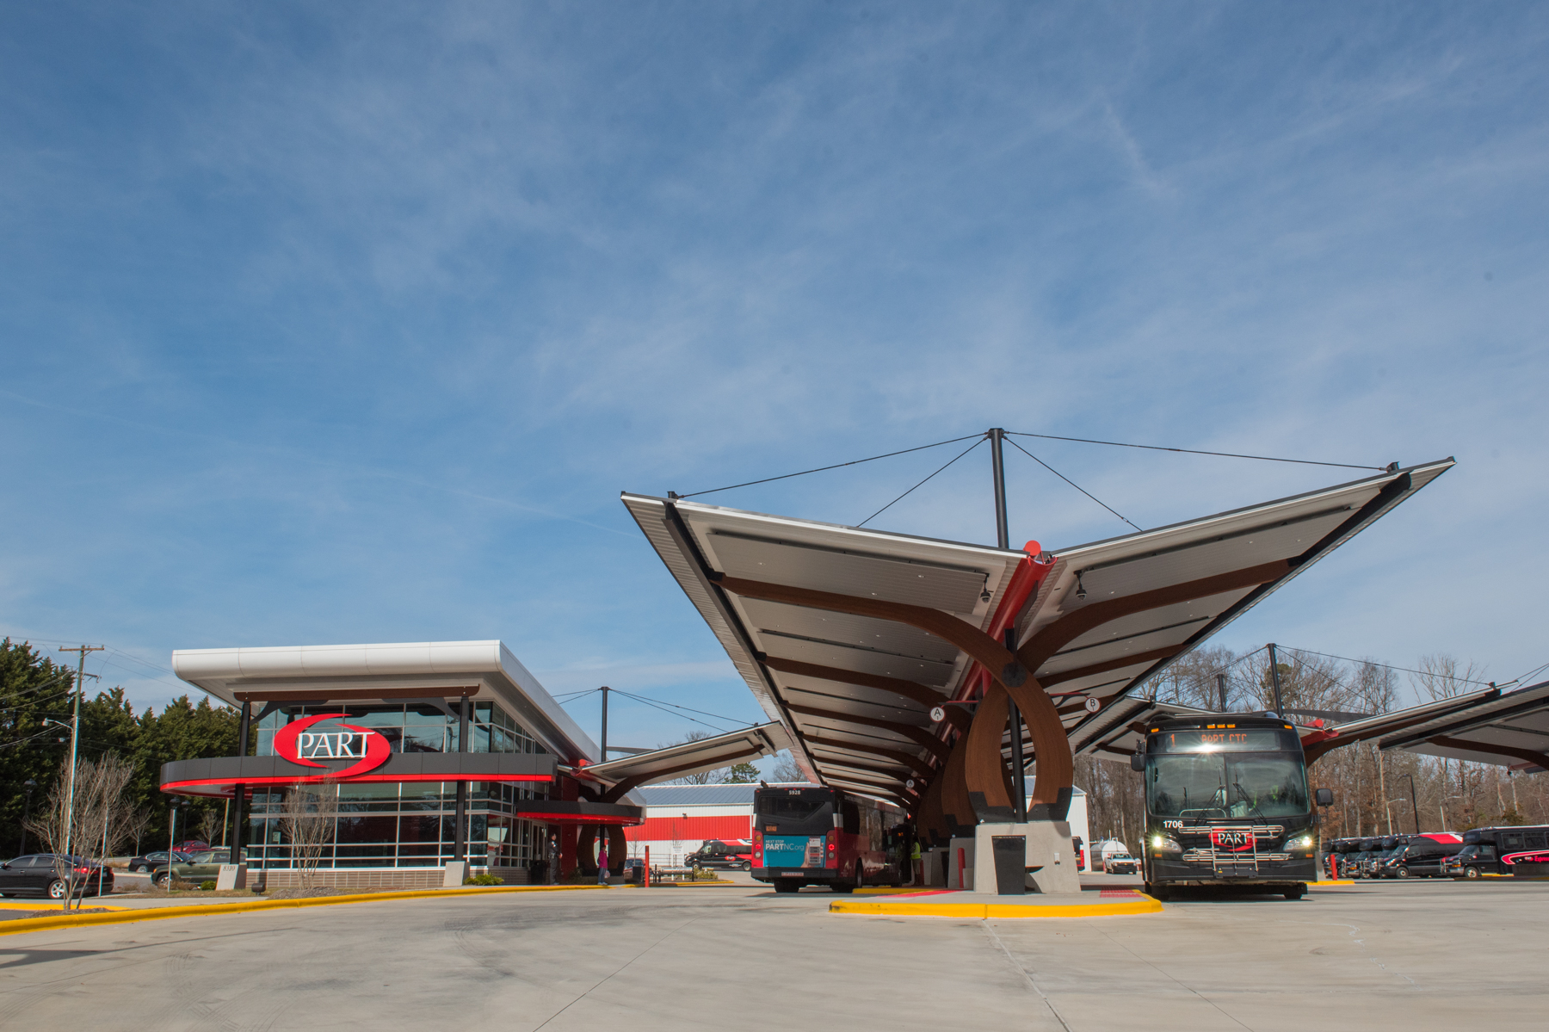
Routes 4 and 6: PART
Two routes
Alamance Burlington Express Route 4
About 4 trips in the morning and 5 in the late morning/evening
Surry County Express Route 6
3 trips in morning and 3 in afternoon/evening
PART Express Routes Annual 2019 Ridership and Revenue Hours
 | Revenue Hours | Hourly Rate | Ridership
Route 4 | 8,760 | $81.72 for 11 months, $83.72 in Dec 2019 | 62,770
Route 6 | 8,760 | $81.72 for 11 months, $83.72 in Dec 2019 | 24,440
Source: PART
Notes:
PART Express Route 4
Operates AM and PM on Monday-Friday from about 5:40 AM until about 7:30 PM
Route 4 offers about 4 trips in the morning and 5 in the late morning/evening
PART Express Route 6
Operates AM and PM on Monday-Friday from about 5:30 AM until about 8:30 PM
Route 6 offers about 3 trips in morning and 3 in afternoon/evening

Slide 12
Thank you! Questions?
Contact Info:
Whit Blanton, FAICP
Executive Director, Forward Pinellas
Email: wblanton@forwardpinellas.org Direct: 727-464-8712
Mobile: 407-620-5984

