Slide 1
Cross Bay Ferry
June 2021
TMA Leadership Group

Slide 2
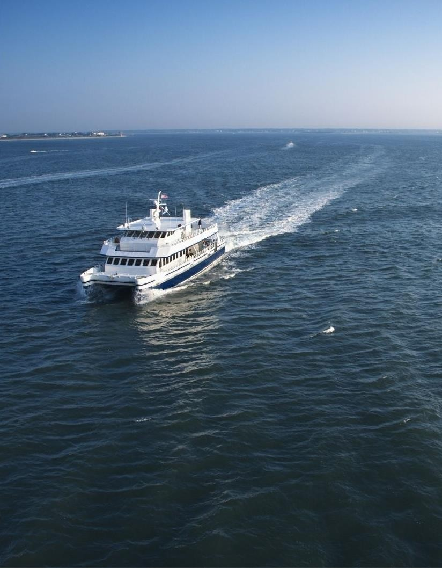
Cross Bay Ferry Seasonal Service
Seasonal Ferry Service between Downtown St. Pete and Downtown Tampa
Pilot Season 2016-2017
Routine Seasons 2018-2021
Multi-jurisdictional investment in public-private partnership
Four local governments during Pilot
FDOT support during Routine Seasons
Maximum subsidy each season with revenue sharing opportunity

Slide 3
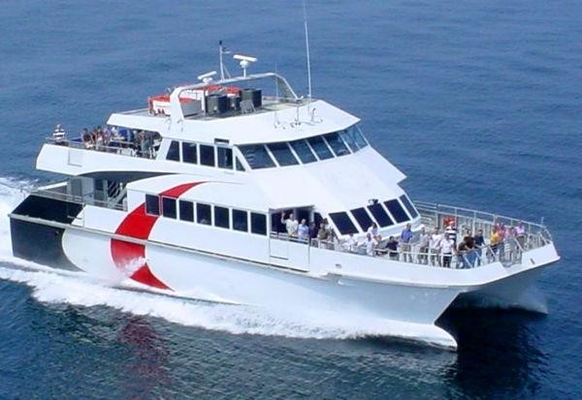
Cross Bay Ferry Seasonal Service
Revenues exceeding threshold of $400,000 would be split 50-50 with HMS and Local Government Partners

Slide 4
Cross Bay Ferry
Concluded third year of 3-year agreement between City of St. Pete and HMS on April 30, 2021
Joint Participation Agreement with FDOT to support the Cross Bay Ferry operations through the three seasons, at approximately $150,000 each season, has concluded with the Service Development grant fully expended

Slide 5
Cross Bay Ferry Seasonal Ridership and Revenue
60,000
$400,000
$355,083
$336,414
$350,000
50,000
$303,377
$294,226
$300,000
40,000
$250,000
PANDEMIC I
MPACTS
30,000
$200,000
52,528
51,658
40,854
$150,000
20,000
38,718
$100,000
10,000
$50,000
-
$0
Pilot Season 2016-2017
Season One 2018-2019
Season Two 2019-2020
Season Three 2020-2021

Slide 6
Cross Bay Inter-City Ferry Going Forward
In April 2021, Hillsborough Board of County Commissioners approved amendment to their agreement with HMS that provides option for inter-city service from Downtown St. Petersburg to Downtown Tampa that could begin in Fall of this year.
Development of new Interlocal Agreement between partner governments with Hillsborough County as lead government agency is underway.
Concept includes consideration for incremental increases in seasonal service until year-round service is achieved; Fall 2021 Season could start at early as October 1 at nearly the same government subsidy.

Slide 7
Questions?
June 2021
TMA Leadership Group

