Slide 1
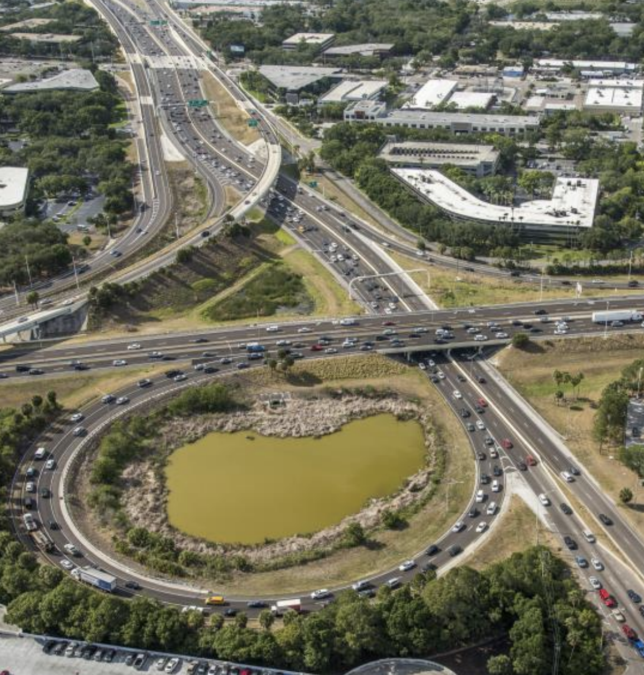
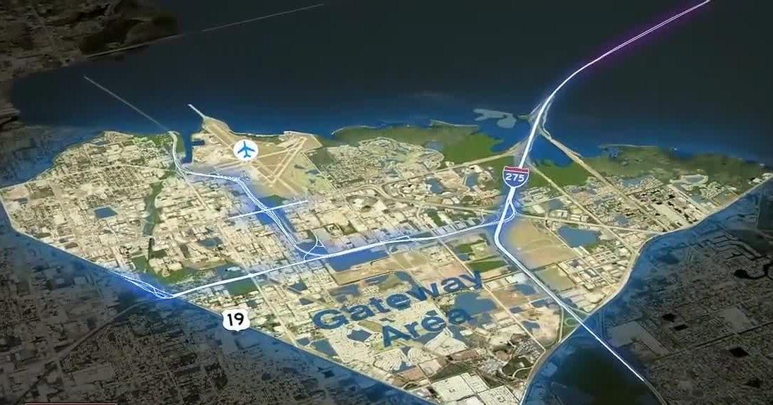
ACTION ITEM
TBARTA MPOs CCC
Transportation Regional Incentive Program (TRIP)
2022 Priority Projects
TBARTA MPOs CCC Board
June 25, 2021

Slide 2
What is TRIP?
Transportation Regional Incentive Program
Part of Growth Management Legislation (2005)
Regional Planning Incentive
State Funds for Regional Travel
Matching Fund Commitment: FDOT will pay up to 50%
Projects Must Be:
Included within the Regional Long Range Transportation Plan
Consistent with the Strategic Intermodal System
Compliance with the corridor management policies
Local Government Capital Improvements Element

Slide 3
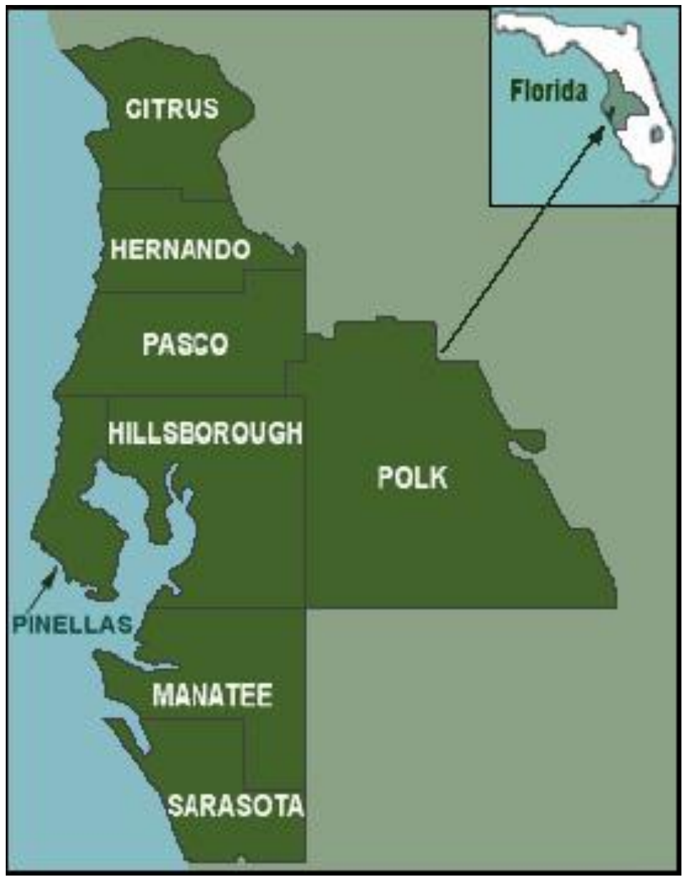
TRIP Prioritization
TRIP Working Group: Two (2) Meetings in Spring/Summer of 2021
Working Group Members: MPOs, FDOT, Florida Turnpike, Counties, Municipalities, Transit Agencies, Airport, Port, and TBARTA
Criteria for Prioritization/Scoring:
FDOT District 1 MPOs Collaborate on Ranking
FDOT District 7 Scoring Matrix
Growth Management, Regionalism, Local Matching Funds
Above: 8-County West Central Florida Region

Slide 4
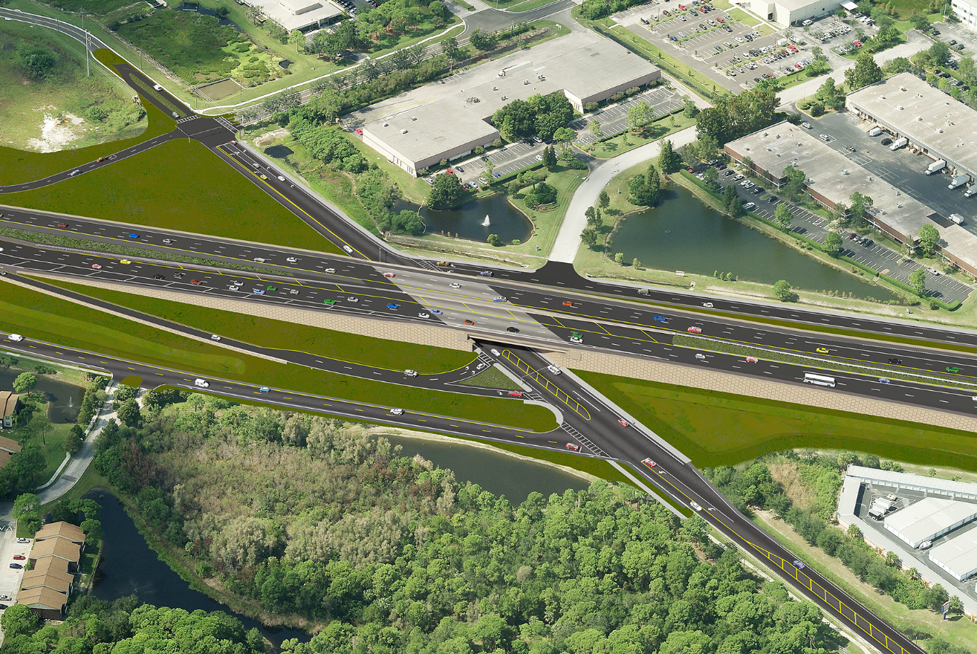
History of TRIP Funded Projects
Constructed | Funded Projects Include:
HART & PSTA – Regional Farebox Program
TBARTA Vanpool Program
Gateway Expressway – Flyover at US19 Pinellas
Gandy Blvd - Flyover Pinellas
Bruce B Downs Blvd – Bearss Ave to Palm Springs Blvd Hillsborough
City of Tampa ATMS Phase I Hillsborough
Iona Road – New Road from Fruitville Road to Palmer Blvd Sarasota
River Road - From US 41 to north of West Villages Parkway Sarasota
Above: Flamingo Fares Logo
Above: Gandy Blvd (Pinellas)

Slide 5
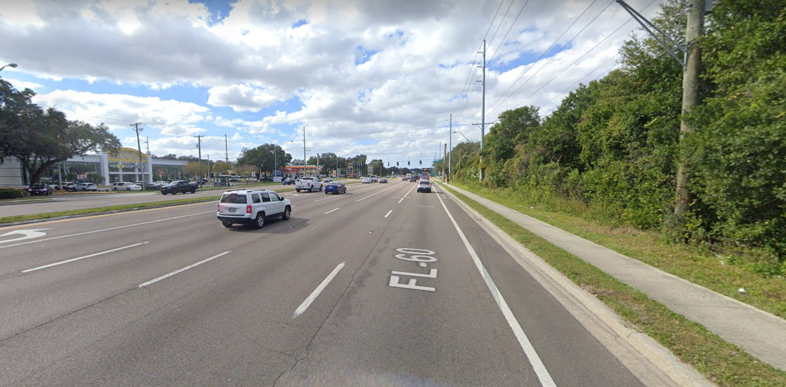
TRIP Programmed Projects (FDOT FY22-26)
Pinellas County (D7)
I-175/I-375/Bayshore DR Downtown St. Pete – ITS Improvements
Above: Bayshore Dr
Hillsborough County (D7)
SR 60/W Brandon Blvd from Lakewood Dr. to Mount Carmel
Above: SR 60/Brandon Blvd

Slide 6
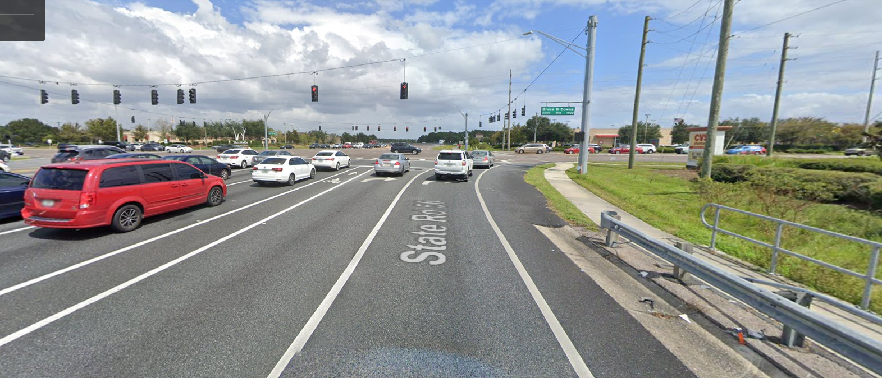
TRIP Programmed Projects (FDOT FY22-26)
Pasco County (D7)
SR 54/56 From Gunn Hwy to SR 581 – ATMS
Overpass Rd from east of Boyette Rd to US 301
Sarasota County (D1)
River Rd from US 41 to north of West Villages Pkwy
Above: SR 54/56
Manatee County (D1 )
US 41 from 10th Ave. to Manatee Ave. E
US 41 Business from 4th Ave. W to 6th Ave. W
3rd St. W from 9th Ave. to Manatee Ave.
Above: US 41

Slide 7
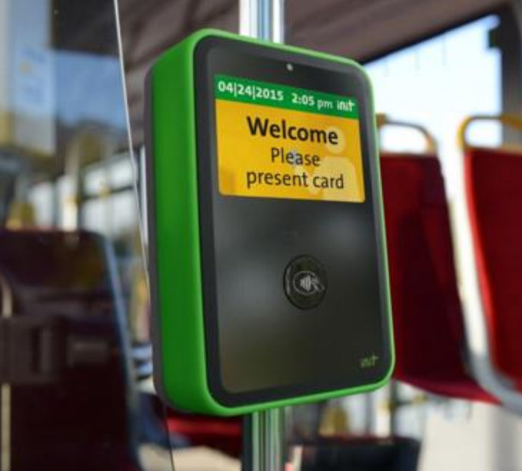
TRIP 2022 Priority Projects – FDOT District 7
1a. I-275/SR 60 Westshore Interchange – FDOT/Hillsborough
County
1b. I-275/SR 93 from south of SR 60 to south of Lois; SR 60 from south of I-275 to SR 589 (Section 4) – FDOT/Hillsborough County
SR 686 from west of I-275 to west of 9th Street N (Roosevelt Connector) – Pinellas County
Little Road ATMS System Expansion – Pasco County
Trinity Blvd. ATMS System Expansion (Little Rd. to
SR 54) – Pasco County
Above: Electronic Fare Collection Reader
Projects ranked according to FDOT D7 scoring

Slide 8
TRIP 2022 Priority Projects – FDOT District 7
Barclay Rd. (SR 50 to Powell) Widening – Hernando County
Old Pasco Rd. from SR 54 to SR 52 – Pasco County
SR 60/Gulf to Bay at Belcher Rd. – Pinellas County
Big Bend Rd from US 41 to Covington Garden Rd and Simmons Loop Rd to US 301 – Hillsborough County (New)
Tower Road from Rangeland to US 41 – Pasco County (New)
Citrus/Hernando County Line Rd from US 19 to Broad Street – Hernando/Citrus Counties (New)
Above: Big Bend Road
Projects ranked according to FDOT D7 scoring

Slide 9
TRIP 2022 Priority Project – FDOT District 1
North Ridge Trail – From Deen Still Rd to Sand Mine Rd – Polk County (New)
Moccasin Wallow Rd – From I-75 east to US 301 – Manatee County
Above: Moccasin Wallow Rd
Project ranked in collaboration between Sarasota/Manatee, Polk, and Charlotte MPO Boards

Slide 10
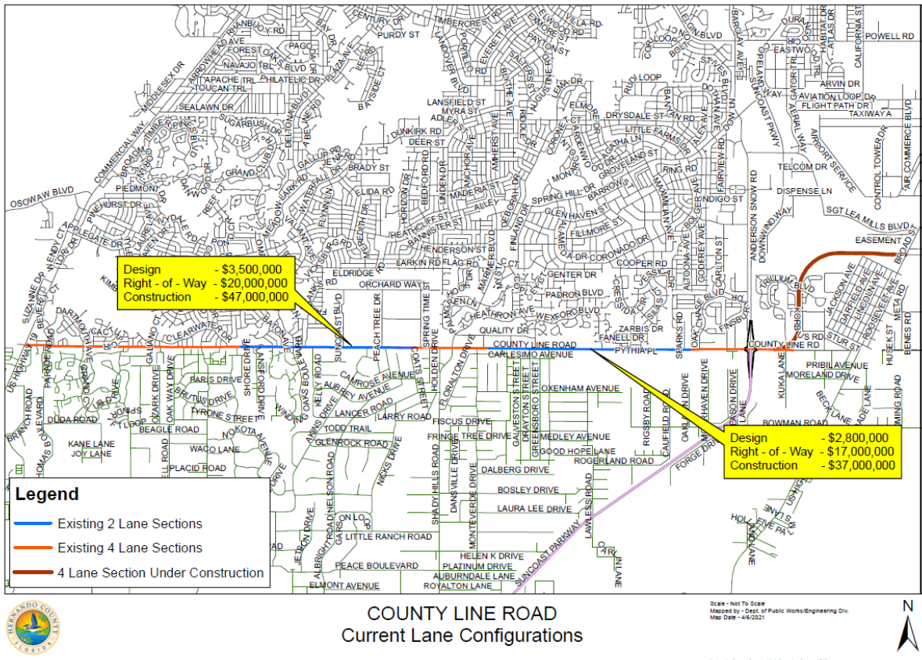
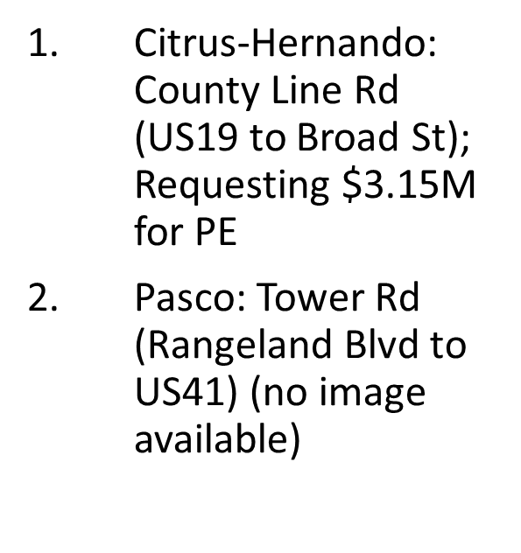
TRIP 2022– New Submissions

Slide 11
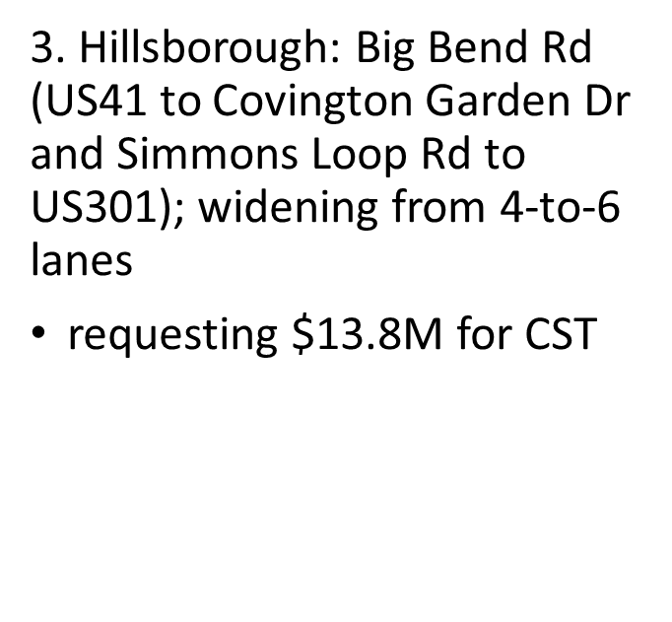
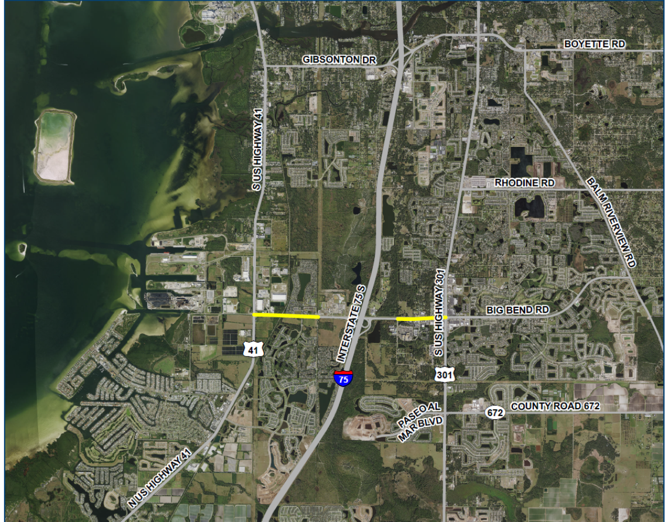
TRIP 2022– New Submissions
4. Polk: North Ridge Trail (Deen Still Rd to Sand Mine Rd (no image available)

Slide 12
ACTION
Recommend approval of District 1 and District 7 FY2022 TRIP Project Priorities and Regional Roadway Network Additions

Slide 13
QUESTIONS?

