Slide 1


TD Tampa Bay
A Partnership to foster transportation
independence and mobility initiatives

Slide 2
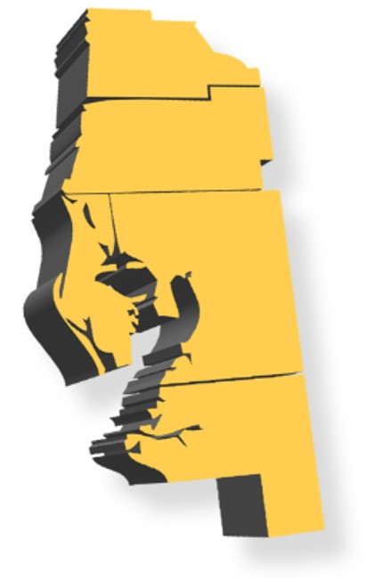

TD Tampa Bay
Pending Innovation and Service Development Grant
Proposed to begin December 1, 2020
UZURV in partnership with TBARTA
Will provide:
Cross-county TD trips
Evening and weekend TD trips for counties where this service is not provided
Does not supplant TD services supplied by local CTCs
Open to eligible TD persons residing in Hernando, Hillsborough, Manatee, Pasco and Pinellas Counties

Slide 3
Purpose:
Increase a TD person’s access to and departure from job training, employment, health care, and other life-sustaining services
Enhance regional connectivity and cross-county mobility for TD persons within the five county TBARTA region
Reduce the difficulty in connecting transportation disadvantaged persons to a transportation hub and from the hub to their final destination (First mile / last mile)

Slide 4
Services:
On-demand and scheduled
Ambulatory and wheelchair accessible
Direct, non-stop, and door-to-door
Provided by credentialed drivers
Trained in disability sensitivity, defensive driving, CPR, HIPAA, etc.
FTA Drug and Alcohol compliant
Passed background screening
Have safe driving history

Slide 5
Funding:
Transportation Disadvantaged Trust Fund
Funds CTCs - Trip & Equipment & Shirley Conroy Grants
Uncommitted funds at end of the year remains in the TDTF
M-CORES Legislation - State Transportation Trust Fund
Allocates $10m/year to the CTD through the STTF
Uncommitted funds at the end of the year returns to the STTF for redistribution to other M-CORES they return to the STTF for

Slide 6
What we ask:
Agencies (MPOs, LCB, Advocacy groups): Assist TBARTA and UZURV in informing TD persons about the service
CTC
Assist TBARTA and UZURV in informing TD persons about the service
Share list of TD eligible persons with TBARTA and UZURV, and/or
Work with TBARTA and UZURV on local eligibility process (UZURV will use customer service representative to conduct eligibility determination)

Slide 7
Riders:
TD eligible in the county where they reside
Schedule Trips
Call the UZURV Muti-lingual Call Center
Use UZURV Rider App
Rider Fare - amount TBD

Slide 8
Contacts:
Chris DeAnnuntis: Project Manager
Chris.DeAnnuntis@TBARTA.com
Brian Pessaro: Principal Planner
Brian.Pessaro@TBARTA.com
Chris Jadick: Director of Communications
Chris.Jadick@TBARTA.com
Steve Holmes: UZURV Vice President Southeast Region
Steve.Holmes@UZURV.com

Slide 9
TD Tampa Bay
A Partnership to foster transportation
independence and mobility initiatives

