Slide 1
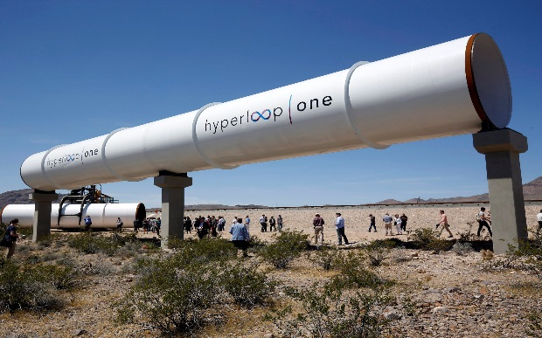
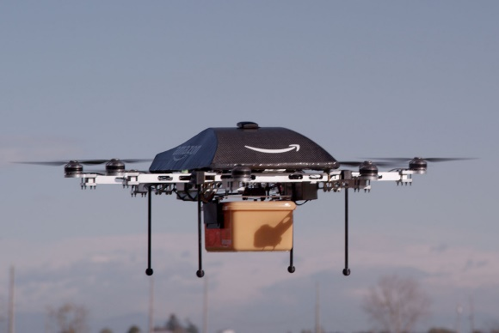
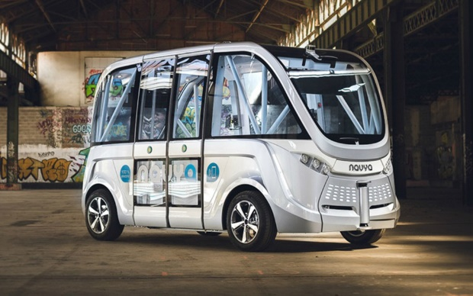
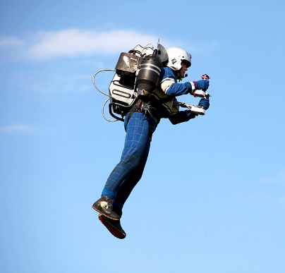
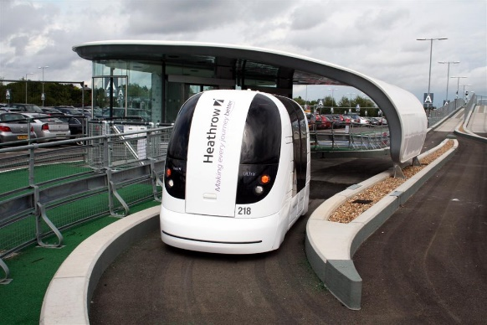
Reimaging Transportation
Pinellas Technology Forum
David Gwynn, P.E.
District Seven Secretary

Slide 2
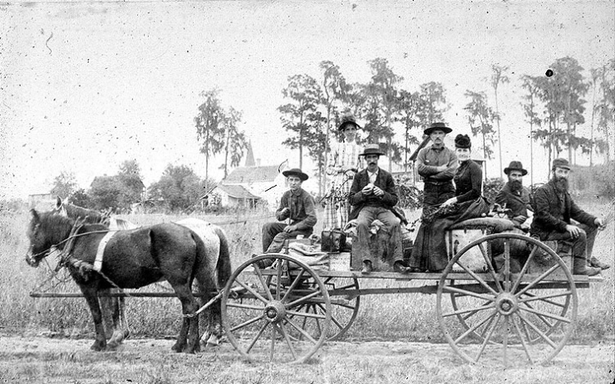
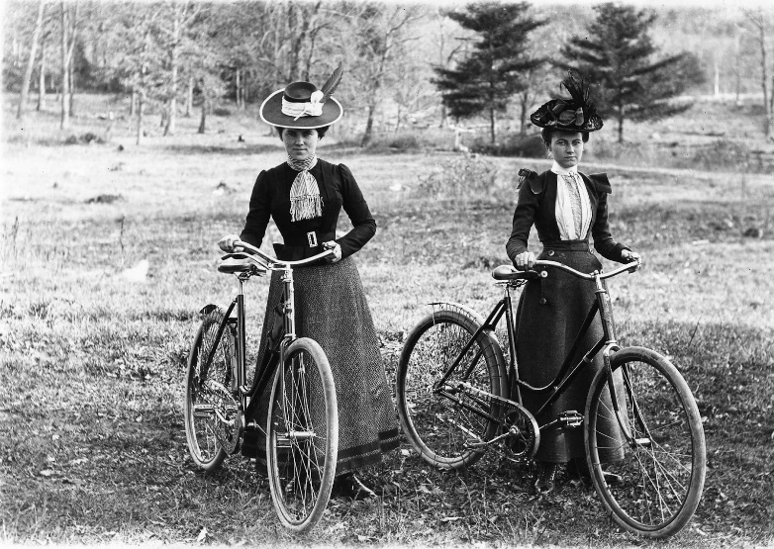
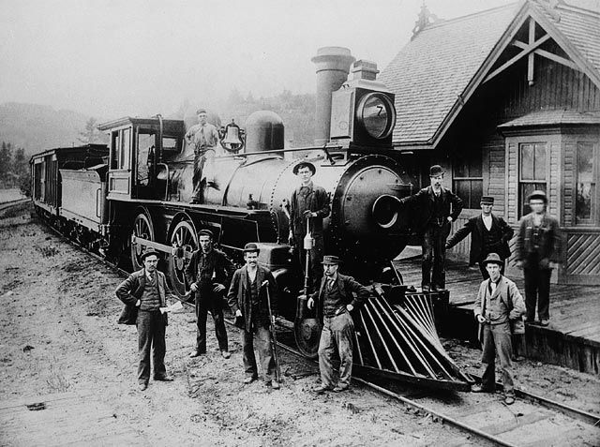
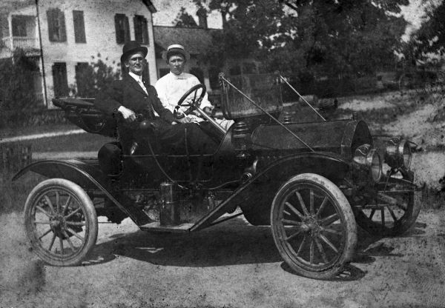
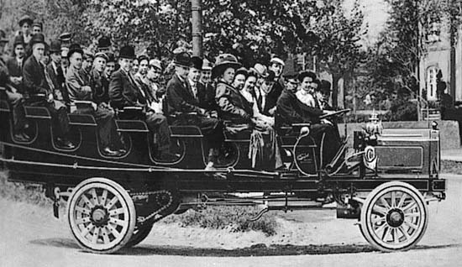
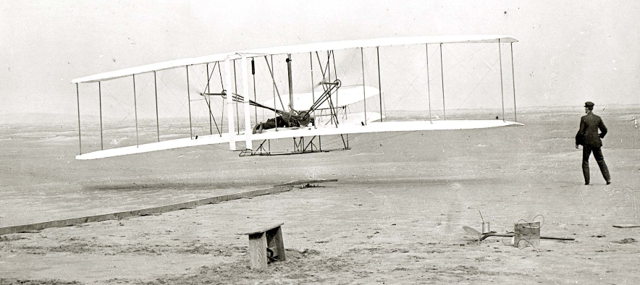
Where have we been?
Source: Winter Park Library Archives
Source: Larry Hart Collection
Source: collectionscanada.ca
Source: floridamemory.com
Source: Britannica Kids
Source: faculty.etsu.edu
2

Slide 3
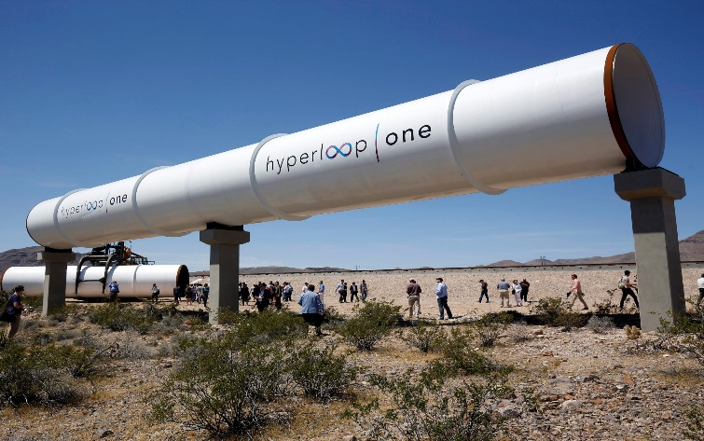
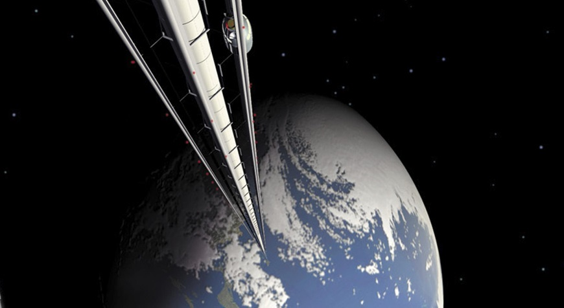
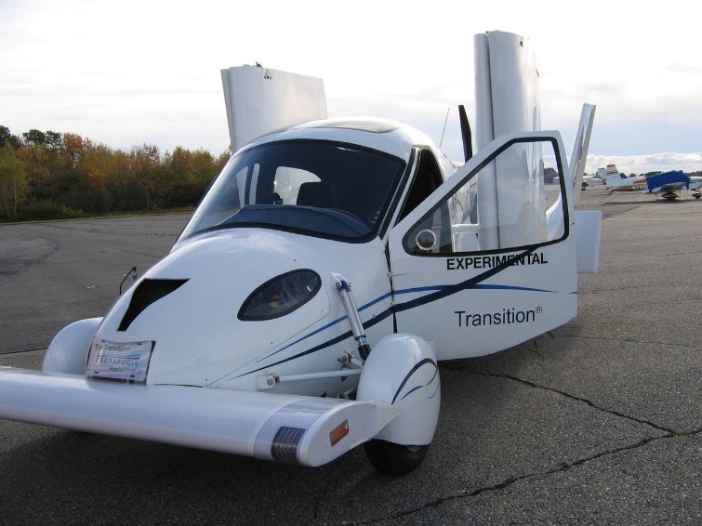
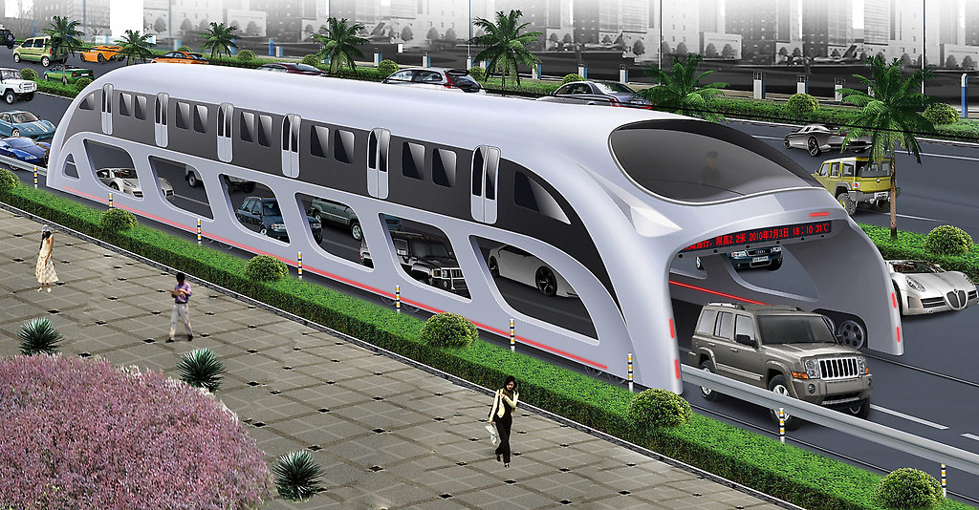
Where will we go next?
Hyperloop
Space Elevator
Flying Cars
Transit Innovation
3

Slide 4
A connected, digital world with smarter streets.
New Demands
on physical and digital infrastructure
Intelligent
Transportation Networks
Big Data Management
Better Mobility and Connectivity
Enhanced Safety
Multimodal Choices
Connected and
Autonomous Vehicles
New Transportation
Platforms
New Supply Chains and Skills Base
Mobility as a Service
Electric Cars

Slide 5
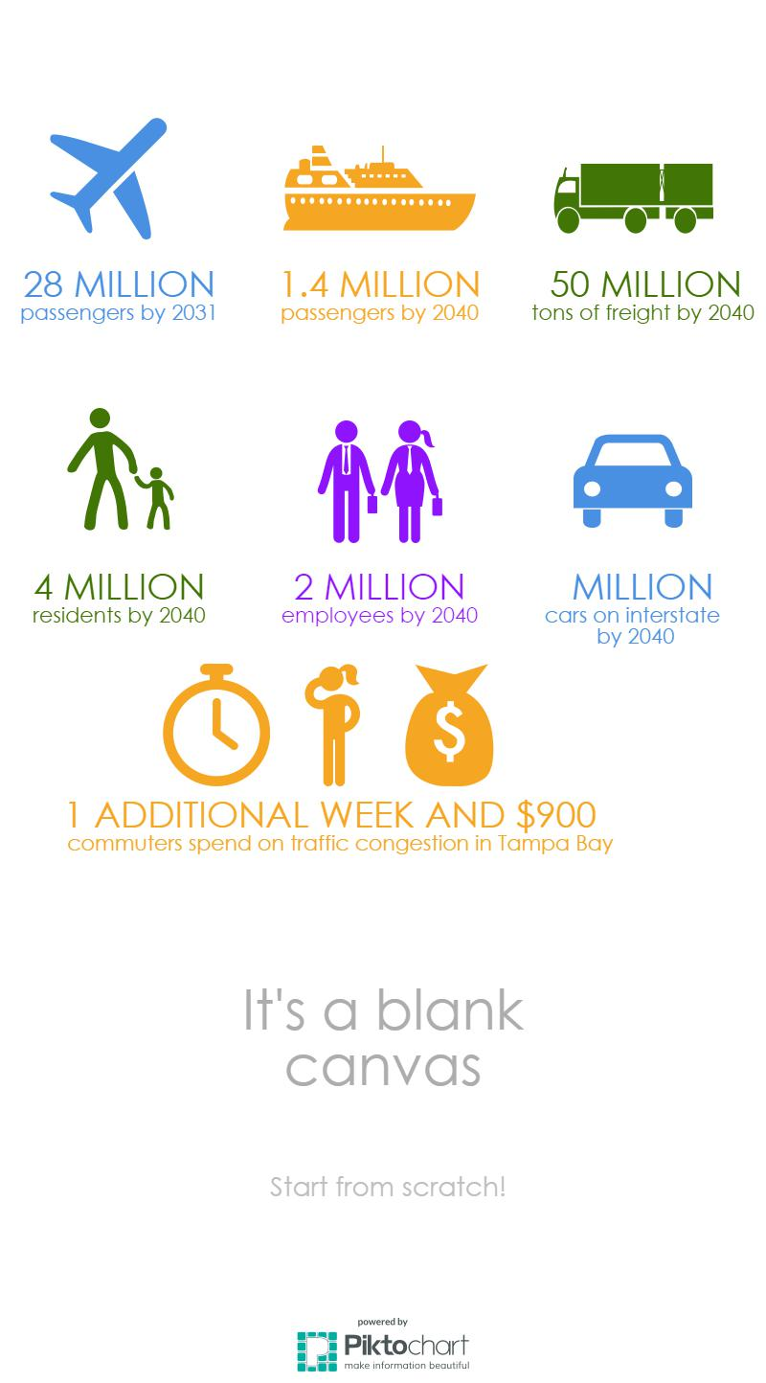
Local Trends (5-County District)
30%
35%
25%
48%
76%
5

Slide 6
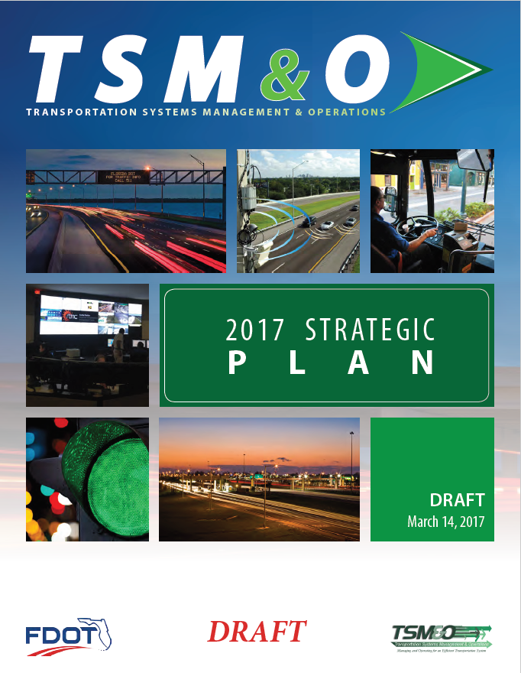
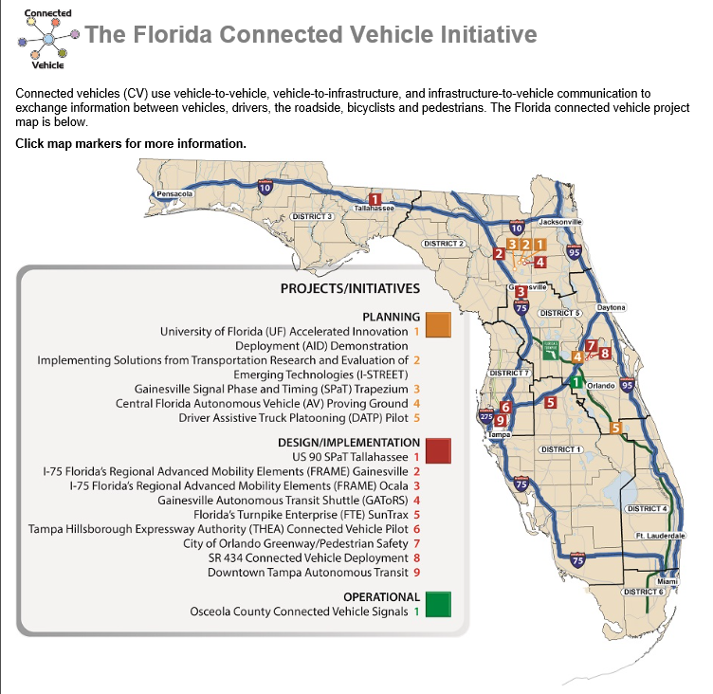
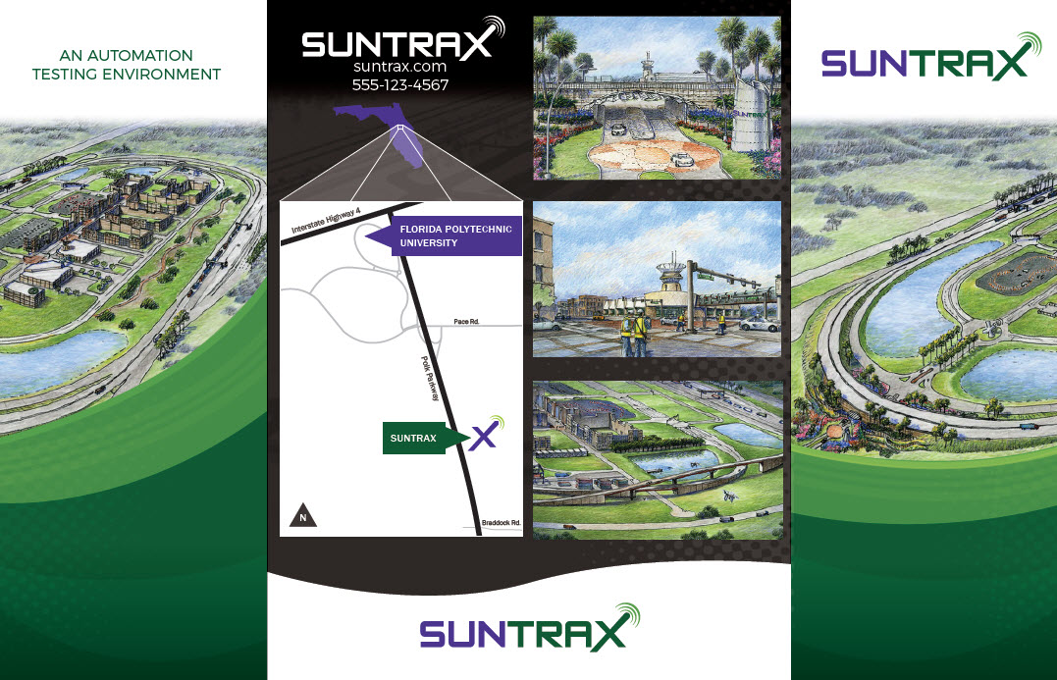

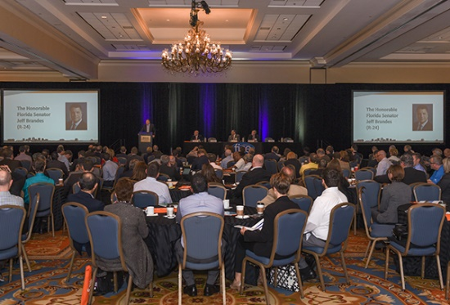
FDOT Statewide Initiatives
Transportation Systems Management and Operations (TSM&O)
Connected Vehicle (CV) Initiative
SunTrax AV/CV Test Track
Florida AV Summit
6

Slide 7
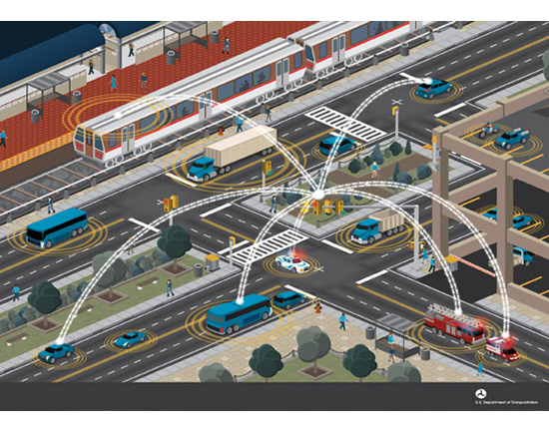
District 7 Initiatives
MOBILITY INNOVATION AND TECHNOLOGY (MIT) TEAM
State of the Practice
Where are we today?
Visioning
Where do we want to be tomorrow?
Roadmap
How are we going to get there?
7

Slide 8
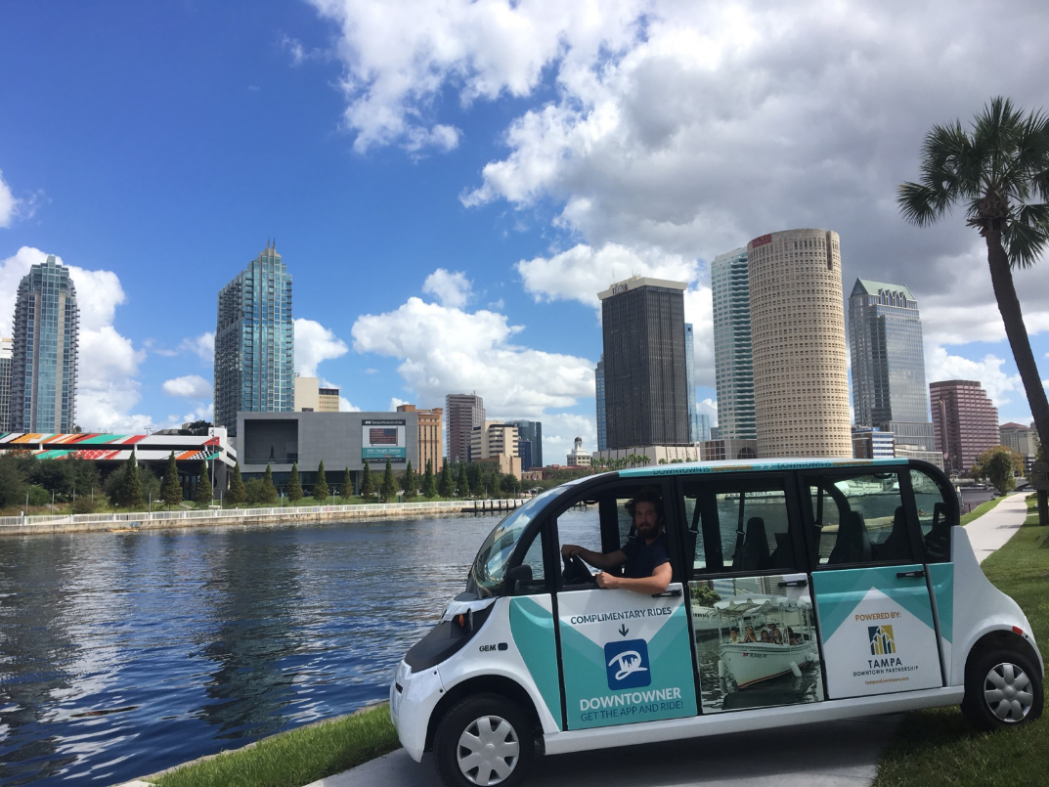
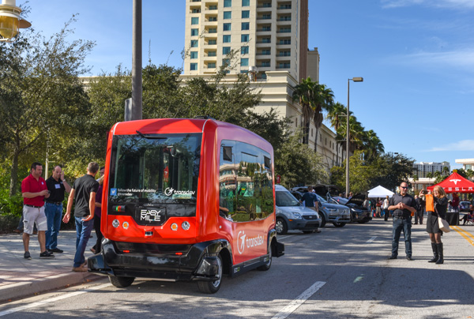






Early Deployments
Downtowner Electric Shuttle
Marion Transitway Autonomous Shuttle
8

Slide 9
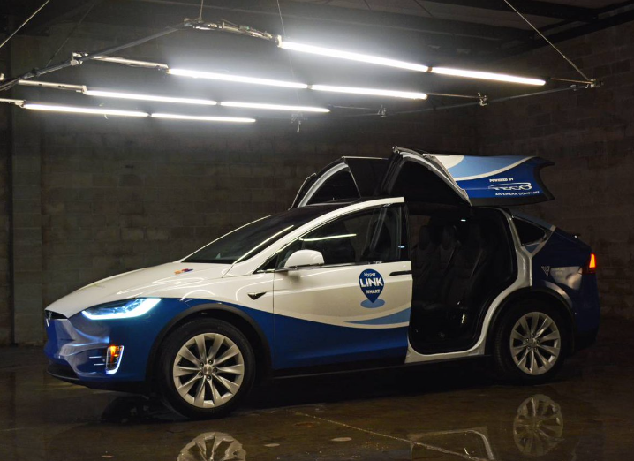
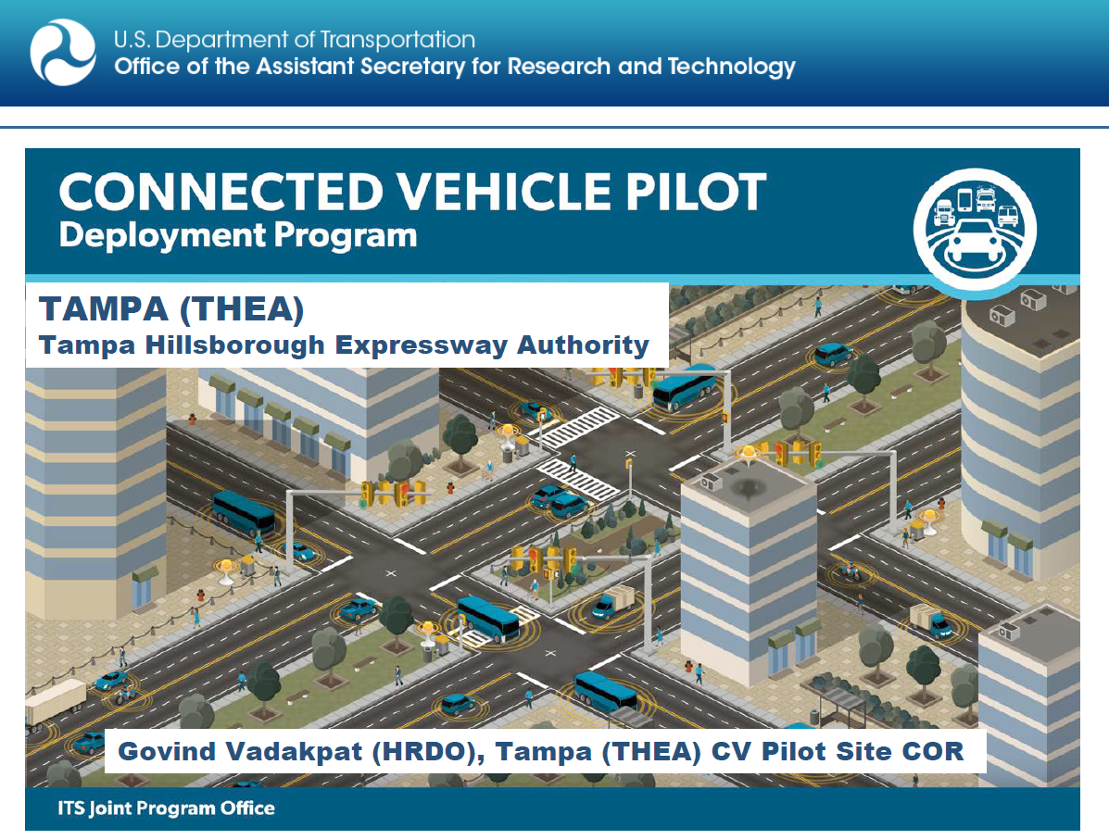

Pilot Projects
Hyperlink Teslas
Downtown Tampa CV Pilot
9

Slide 10
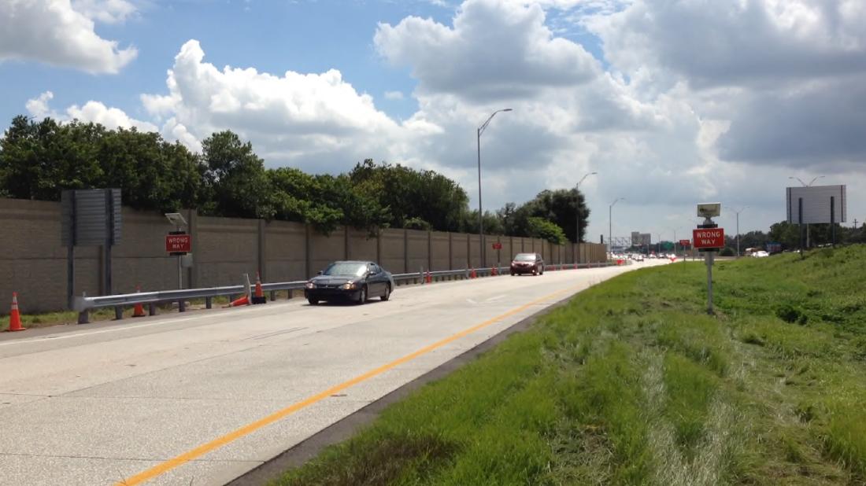
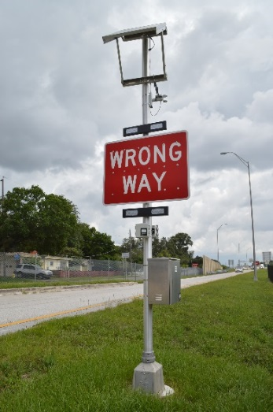


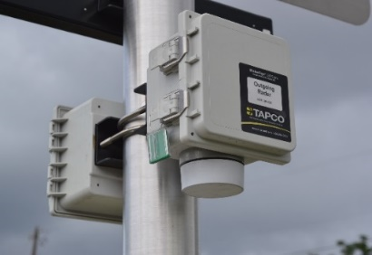

Early Deployments
Wrong Way Driving
10

Slide 11
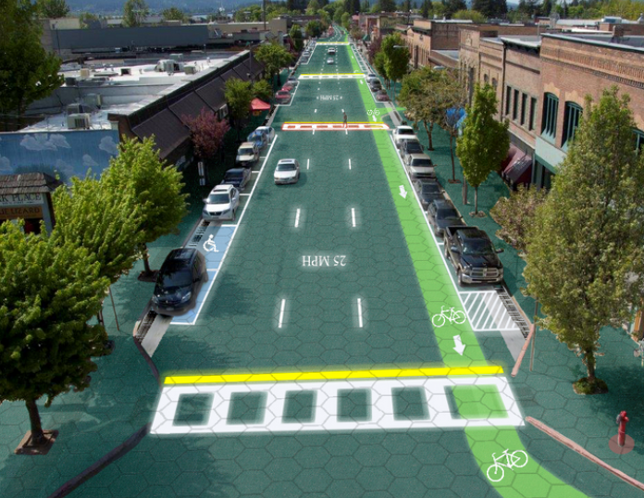
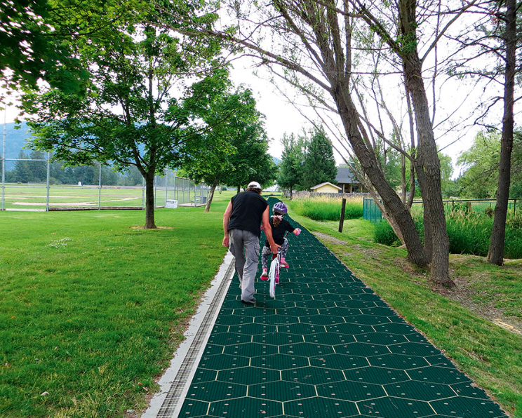

Research
Solar Roadways and Trails
and
11

Slide 12
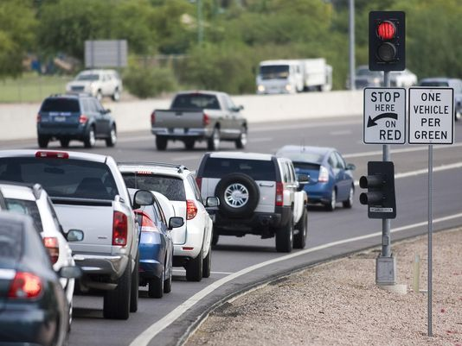
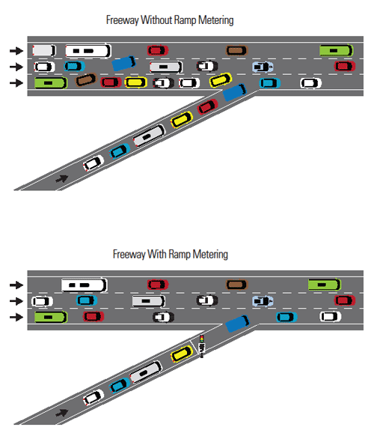
On the Horizon
Ramp Metering
Freeway without Ramp Metering
Freeway with Ramp Metering
12

Slide 13
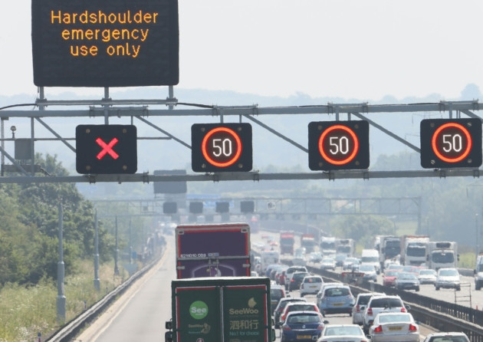
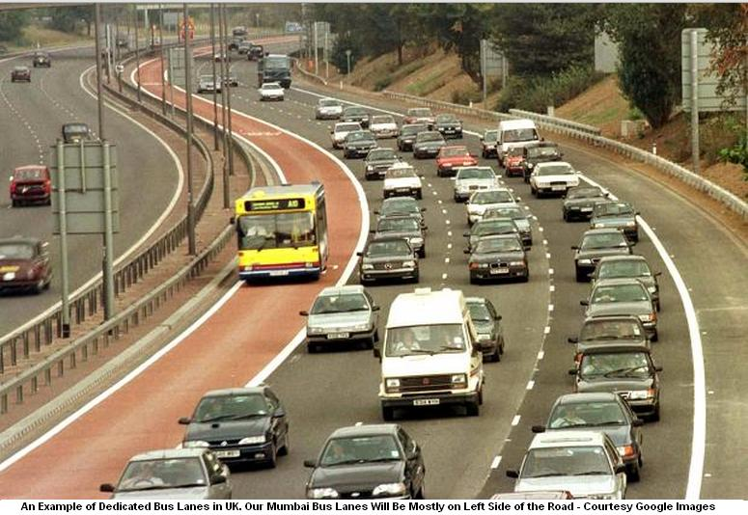
Hard Shoulder Running
On the Horizon
13

Slide 14
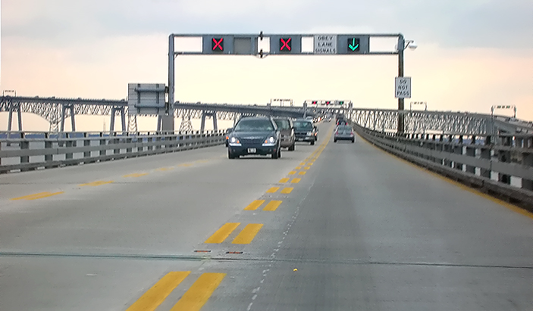
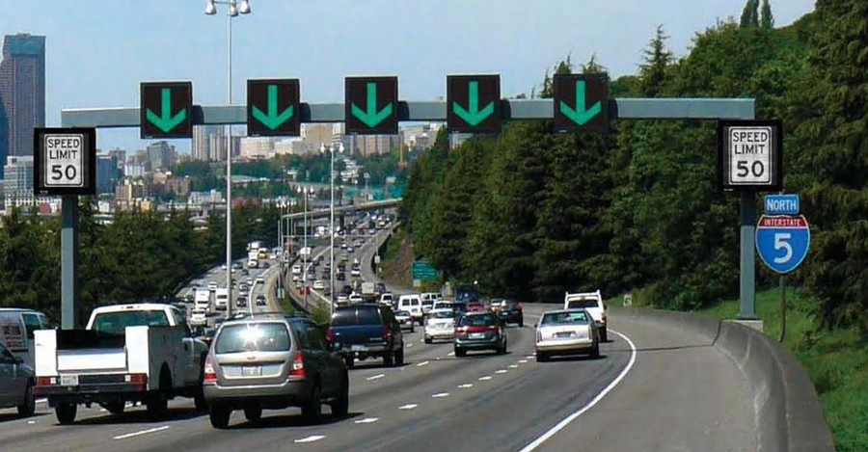
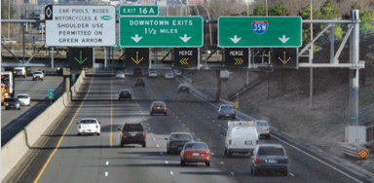
Adaptive Lane Controls
On the Horizon
14

Slide 15
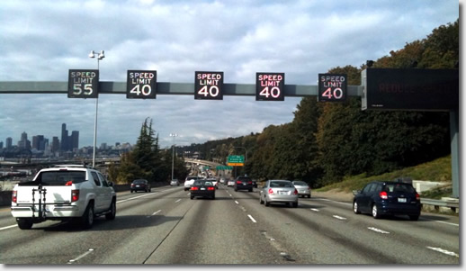
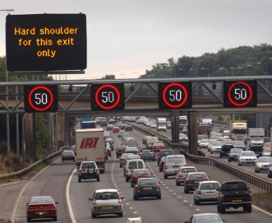
Variable Speed Limits
On the Horizon
15

Slide 16
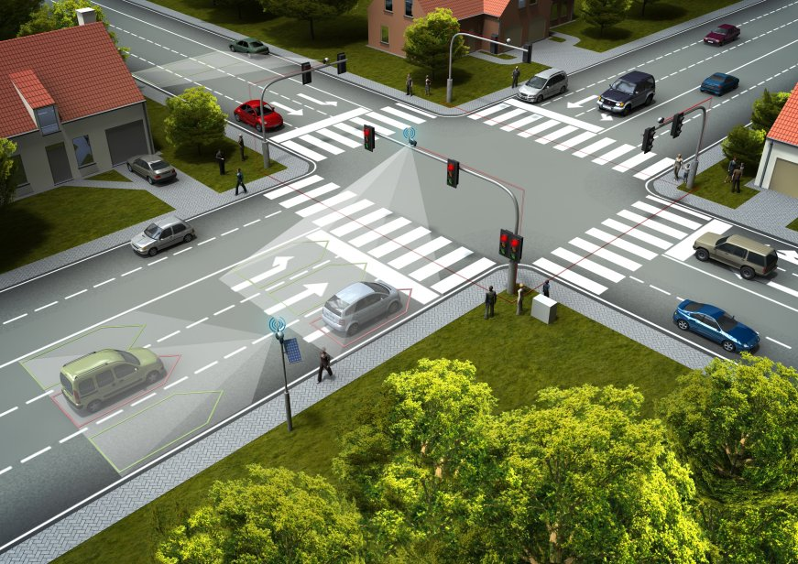
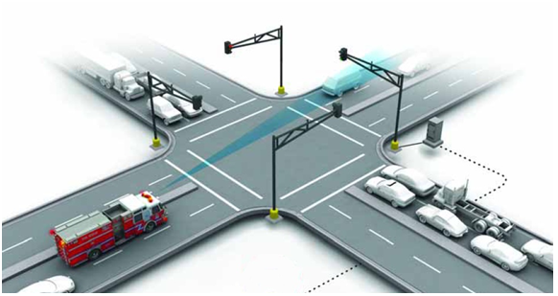
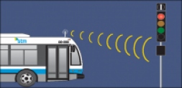
Adaptive Signal Controls
On the Horizon
16

Slide 17
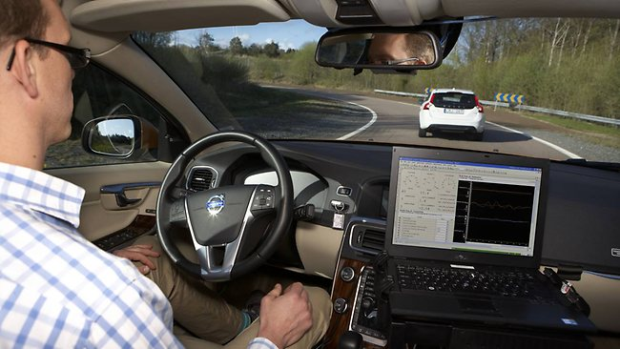
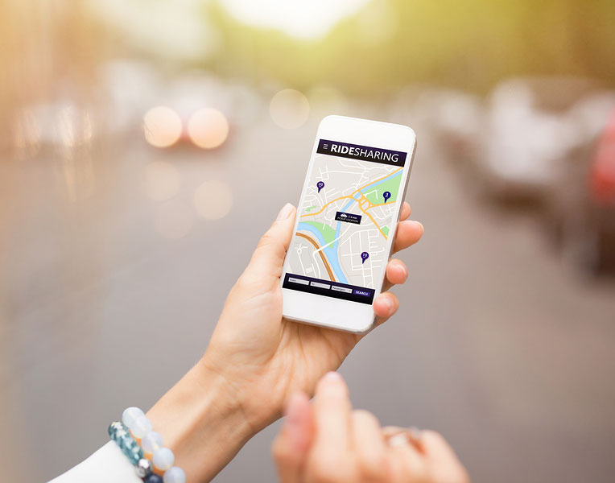
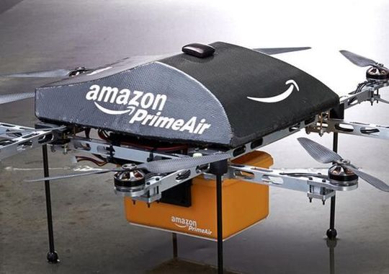
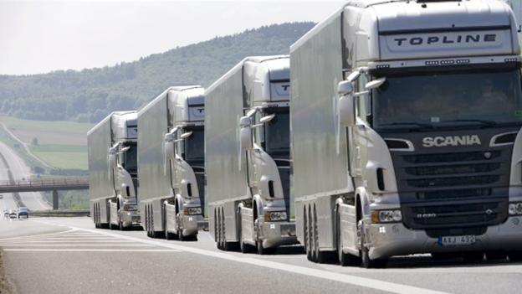
Things to watch
On the Horizon
Autonomous and Connected Vehicles (AV/CV)
Shared Mobility
Innovative Commerce and Deliveries
Platooning
17

Slide 18


Slide 19



David Gwynn, P.E.
District Seven Secretary
813-975-6000
david.gwynn@dot.state.fl.us
FDOTtampabay.com
FDOT West Central-Tampa Area
@myFDOT_Tampa
FDOT District 7
19

