Slide 1
Assessing the Applications of a Light, Autonomous Vehicle on the USF Tampa Campus
Forward Pinellas Technology Forum, Sept. 28, 2017

Slide 2
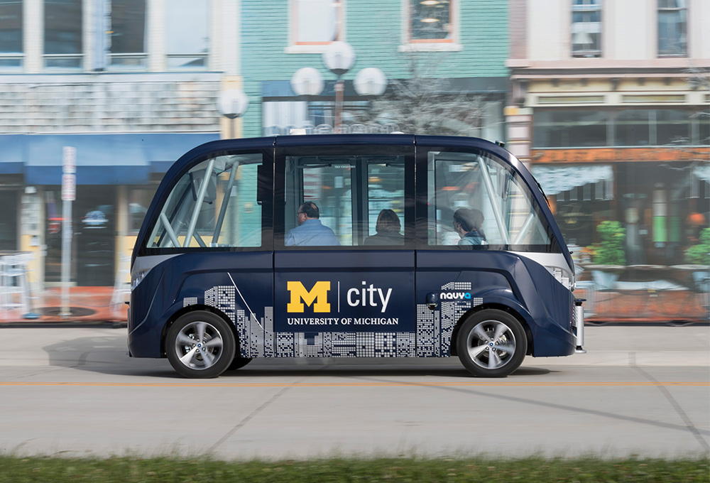
University of Michigan Driverless Shuttle
https://www.youtube.com/watch?time_continue=46&v=P0cH9WIQwt8

Slide 3
University of Michigan Driverless Shuttle
Service starts this fall
2, 15-passenger electric shuttles
2-mile route on U-M roads
Shuttles made by French firm NAVYA

Slide 4
Study Tasks
Identify areas of USF campus that could be served by a driverless shuttle
Identify legal and insurance restrictions to operating a driverless shuttle on campus
Identify 2 to 3 service options

Slide 5
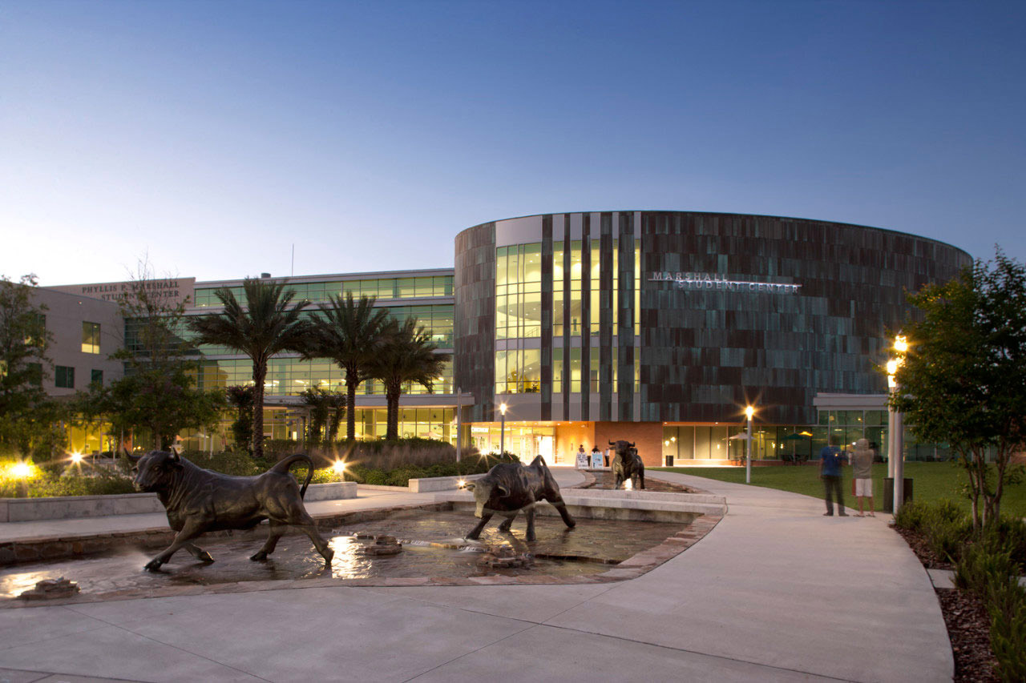
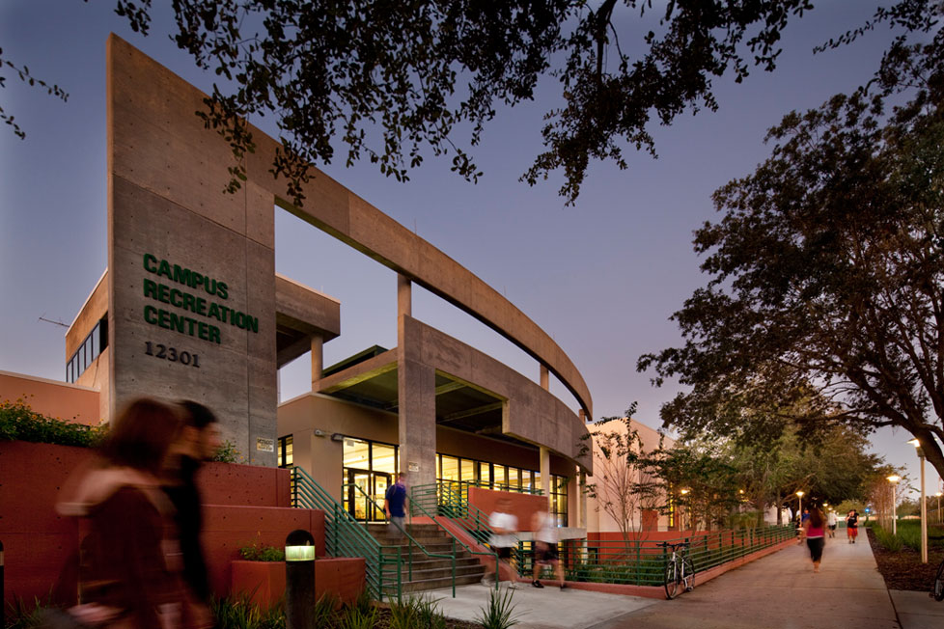
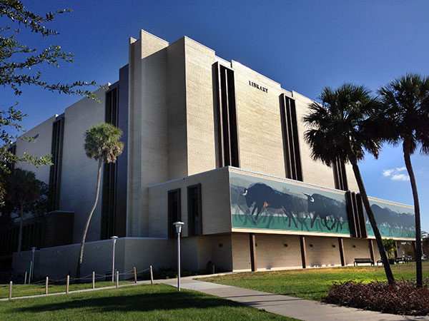
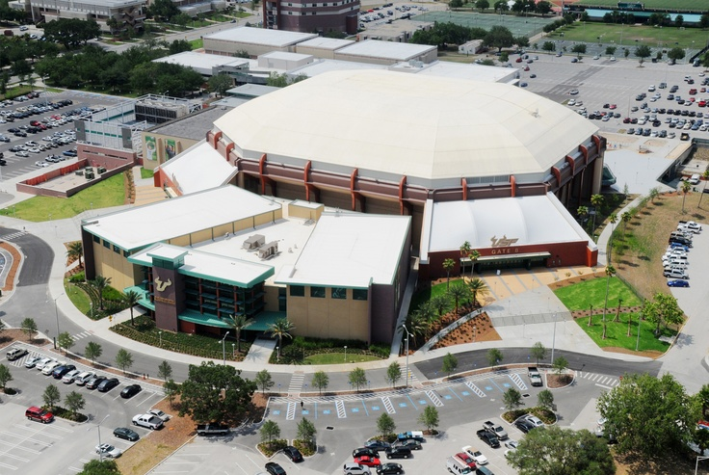
Study Tasks
Identify areas of USF campus that could be served by a driverless shuttle
Marshall
Center
Rec
Center
Library
Sun Dome

Slide 6
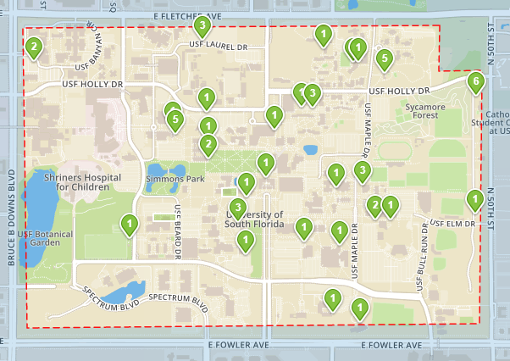
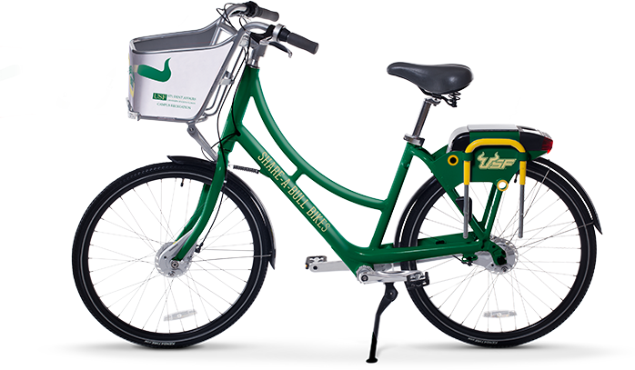
Study Tasks
Use existing data sources to understand student travel patterns

Slide 7
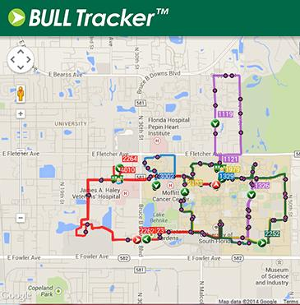
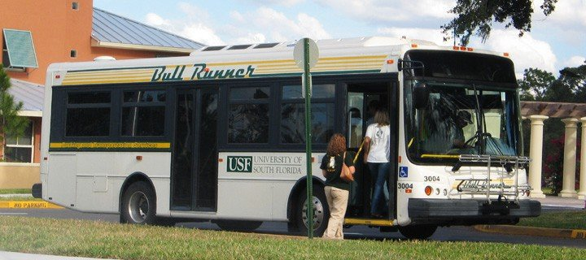
Study Tasks
Use existing data sources to understand student travel patterns

Slide 8
Study Tasks
Identify legal and insurance restrictions to operating a driverless shuttle on campus
Requiring an attendant to be on-board for safety
Restricting the max allowable speed

Slide 9
Study Tasks
Identify 2 to 3 service options
Campus circulator
Parking shuttle
First mile/last mile connector to BullRunner
On-Demand Evening Shuttle
Transportation for students with disabilities
Medical campus service
Special event shuttle

Slide 10
Contact Information
Brian Pessaro
Senior Research Associate
CUTR
University of South Florida
pessaro@cutr.usf.edu
(813) 974-5113

