Slide 1
Sharing Data
The significance of two-way data exchange to support transportation planning and operations
Notes:
Introduction

Slide 2
Why is it important to share data?
Because effective decision-making processes must be informed by good data
AND
Thankfully, there are many, many datasets produced in the Tampa Bay Region
BUT
No single agency has access to all data necessary to make an informed decision
Notes:
Background
*Emphasize the need for data to inform decision-making.

Slide 3
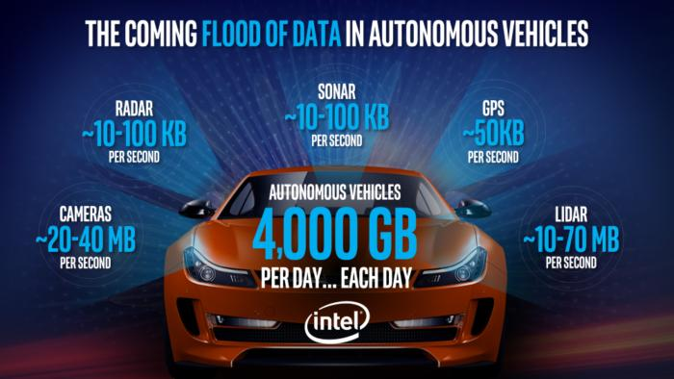
Notes:
Poorly managed datasets AND data which are unavailable to decision-makers generates productivity losses.
In transportation, this can translate to congestion and injuries/fatalities.

Slide 4
Notes:
Effective decision-making requires frictionless access to good data.

Slide 5
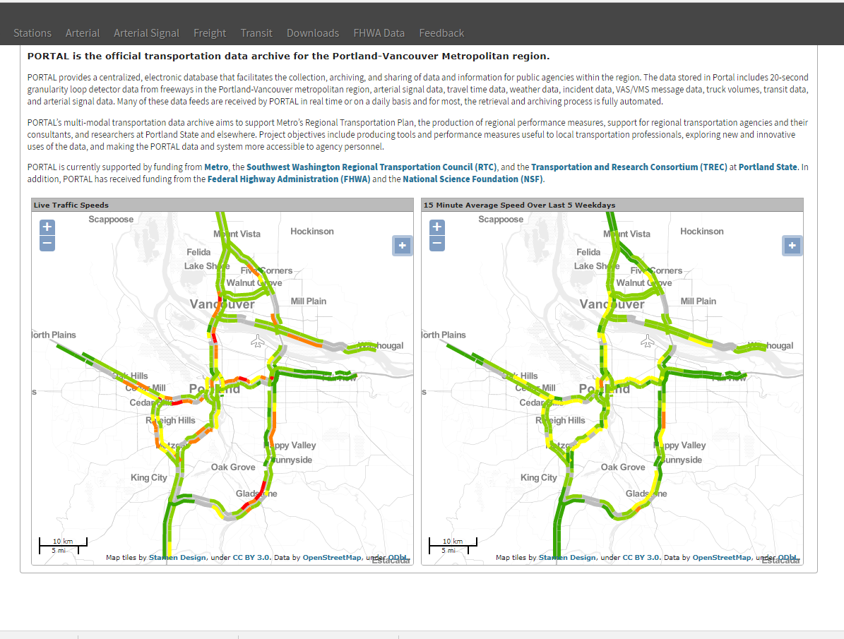
Shared data portal
Sample from Portland Metro
Data Archive
Notes:
One of three MPOs nationwide to participate in the pilot study. Goal was to improve regional collaboration of transportation data collection and management. Plan is now finalized.
RBDWG was created to obtain buy-in from stakeholders around the region and establish business rules and processes for providing and accessing data.
The centerpiece of the plan is a shared portal/platform which will allow government, business, academic, and even general public users to upload and download transportation datasets.

Slide 6
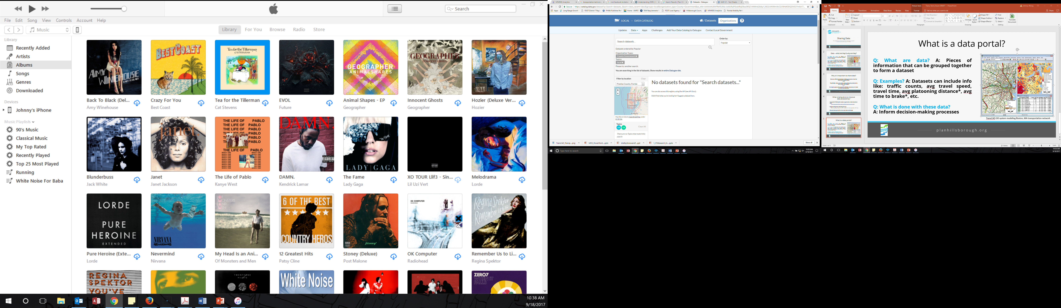
Shared data portal
Sample from US Open-Data Exchange

Slide 7
How will shared data support planning and operations?
More accurate congestion management systems
Shorter-term and finer-scale travel demand forecasting
Improved calibration of regional travel demand models
Improved travel time reliability
Visit http://www.planhillsborough.org/fhwa-data-business-plan/
for more information
Source: Robert M Winick, 1998. North American Travel Monitoring Exhibition
Notes:
Talking point: This data effort is part of acknowledging that we can’t build our way out of congestion, and we have to get smarter about how we use our limited resources. Roads that are predictably congested don’t create as much hardship for commuters and shippers as roads that are congested to the point of having wildly unreliable travel times. Sharing the data that’s already being collected about speeds/travel times will help us focus limited dollars objectively.

Slide 8
Next Regional Big Data Working Group meeting:
October 26, 2017 @ 2p
601 East Kennedy Blvd 18th floor
Tampa, FL 33602
For more information, please contact
Johnny Wong, PhD
wongj@plancom.org
813-273-3774 x370

Slide 9
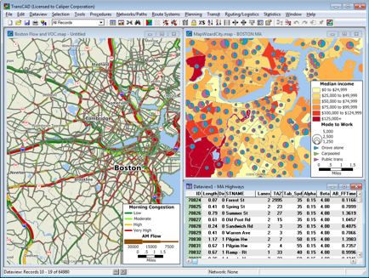
Data – what are they & why are they?
Q: What are data? A: Pieces of information that can be grouped together to form a dataset
Q: Examples? A: Transportation datasets can include info like: traffic counts, avg travel speed, travel time, avg platooning distance*, avg time to brake*, etc.
Q: What is done with these datasets? A: Inform decision-making processes
TransCAD GIS system modeling Boston, MA transportation network

Slide 10
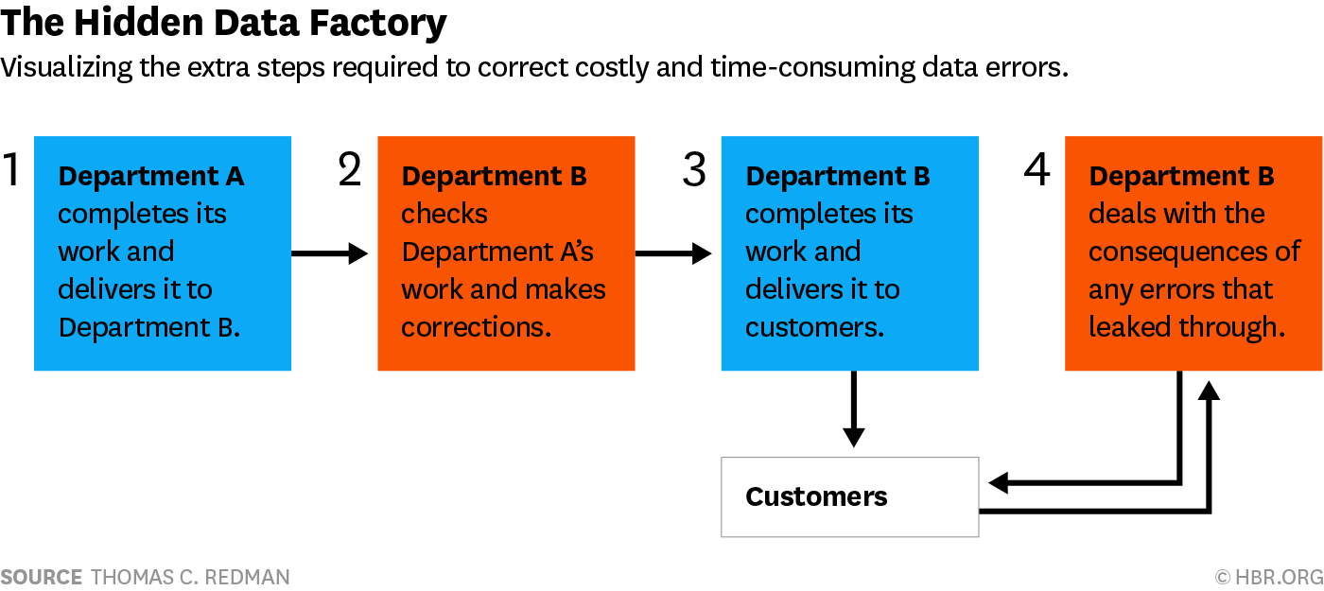
A 2016 study estimates that bad data costs the US $3.1 trillion of lost productivity annually
Credit: Thomas C Redman, 2016. Harvard Business Review.

Slide 11
What is being done to improve data quality & accessibility?
12-month FHWA pilot study to generate a data business plan
  http://www.planhillsborough.org/fhwa-data-business-plan/
Regional Big Data Working Group
  Next meeting: October 26, 2017 @ 2p; 601 E Kennedy Blvd, 18th floor
Shared data portal for two-way data exchange…

